Slide 1


An outlook of the global and European dairy markets
Christophe Lafougere, Gira
XXX forum, 3rd of October, 2019
contact@girafood.com
Tel: +33 4 50 40 24 00
www.girafood.com

Slide 2
Global Supply Developments

Slide 3
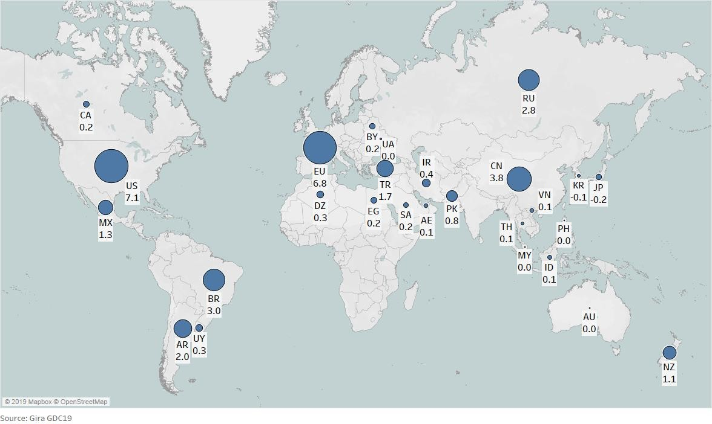
Milk Collection Growth to 2024
EU & US main drivers of growth; 2019-2024: +32.4 mio tons
GDC World milk collection change in total in 2019 to 2024, in ‘000 tons
EU+US+NZ+AR milk collection growth
+4.4 mios tons in 2017/16
+3.6 mios tons in 2018/17
+1.3 mios tons in 2019/18
Less than 3.6 mios tons in 2020/19?

Slide 4
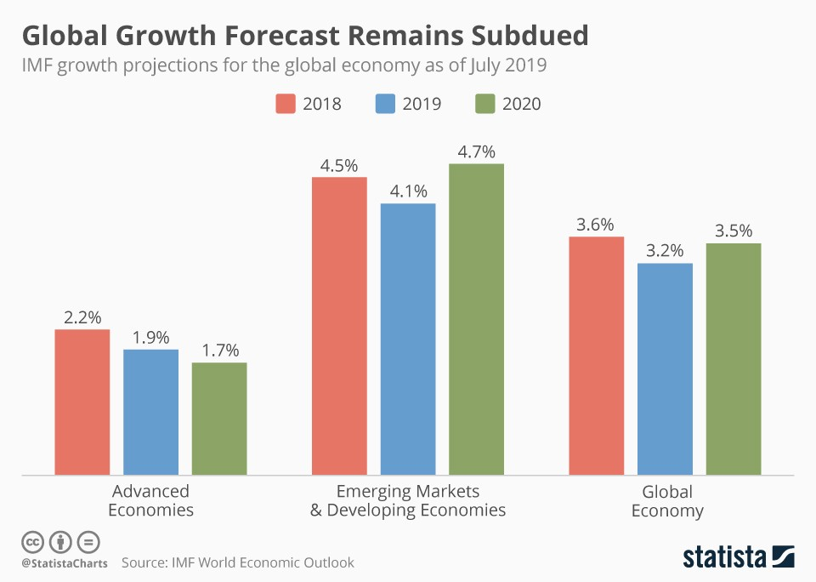
Global Growth Forecast Remains Subdued
“The projected growth pickup in 2020 is precarious, presuming stabilization in currently stressed emerging markets and developing economies and progress toward resolving trade policy differences” IMF

Slide 5
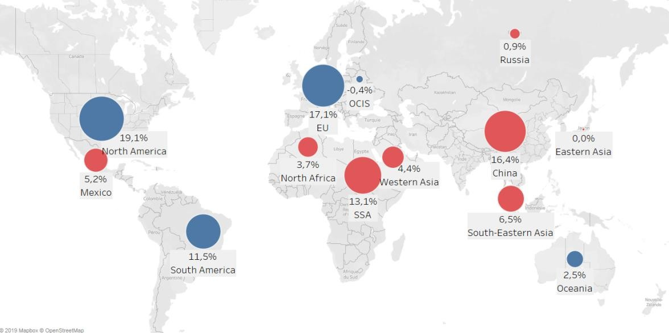
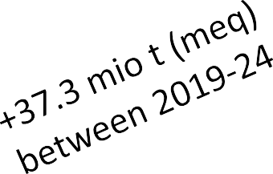
Dairy consumption by regions (meq): 517 million ton (excel. IN & PK)
Asia will remain as the most promising market
Contribution of the Region to Total consumption growth, 2019-24f
Net exporters
Net importers
Source: Gira compilation

Slide 6
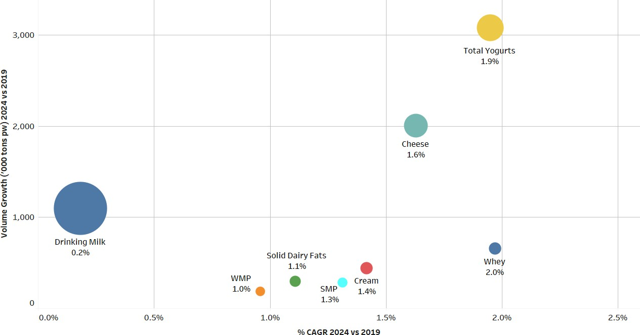
Production growth by main categories of products
Cheese will continue to attract more milk
Production Growth in GDC Countries (excl. India & Pakistan) 2024 vs. 2019
The size of the bubble is proportional to the production volume in 2019
Source: Gira GDC 19

Slide 7
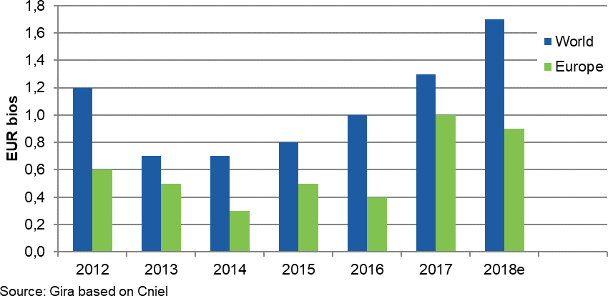
Investments in cheese are accelerating
Mainly in the US, EU and now also some large projects in Russia
USA: Glanbia plc, DFA and Select Milk Producers plan to build a cheese plant with 135 000 t capacity + whey valorisation in Michigan.
US: Agropur has invested EUR 170 mios in its Lake Norden (South Dakota) cheese plant. Capacity = 4 mios l processed per day.
EU: new mozzarella plant in ROI for
Glanbia (170 mios €/45’000 tons)
New investments* in Cheese 2012-2018
New capacity for mozzarella (US+EU):
r a first plant in o build plants in
Russia: Eko-Niva afte
Voronezh is starting t
Novosibirsk (EUR 24
more than +350’000 tons (18/19)
0 mios) and Moscow
regions. Plus many other projects
* Investments announced in medias
Source: Gira based on Cniel

Slide 8
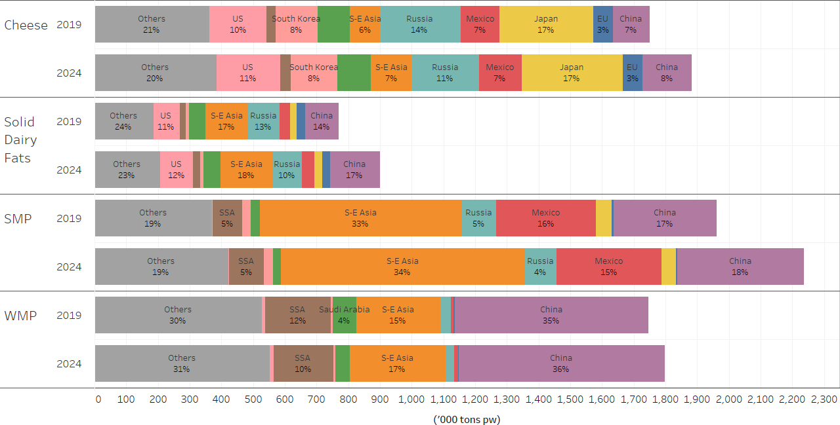
Commodity Imports: Continued Growth
Cheese and SMP imports to be key growth products
Dairy Imports by Commodity and by Country (excl. IN), 2019-2024
+154,000 t
+136,000 t
+275,000 t
+52,000 t
Source: Gira GDC19

Slide 9
Has Market Balance Returned?

Slide 10
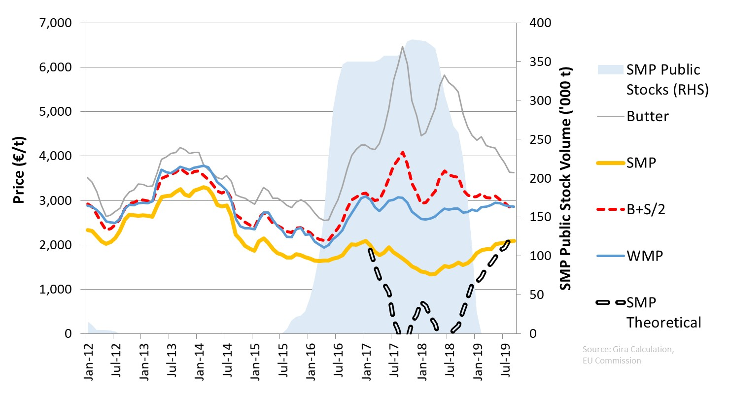
Market Balance Testing
Has market balance now returned? B+S/2 would suggest yes
EU: Butter+SMP/2 vs WMP, 2012 to Sept-19

Slide 11
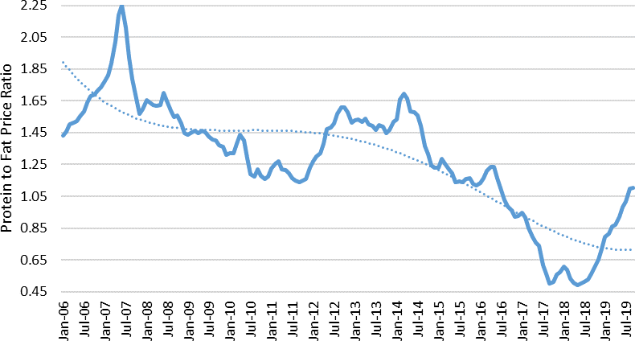
Protein to Fat Price Ratio in the EU: SMP & Butter
Back to parity as market normality returns; how strong is fat demand?
EU Protein to Fat Price Ratio, 2006 to Sep-19
Markets out of balance

Slide 12
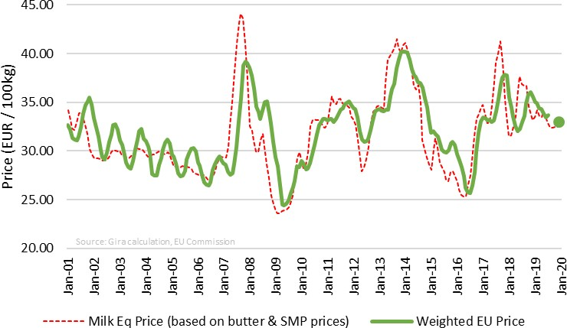
SMP/BU as a Proxy for Milk Prices
Butter decline outweighs rising SMP→ milk price outlook weakening
Average EU Raw Milk Price v Calculated EU Milk Eq Price, 2001-19 M7
3 month lag
R² = 0.87
€33/100kg
Dec-19 price assumption:
SMP = €2.25/kg BU = €3.45/kg

Slide 13
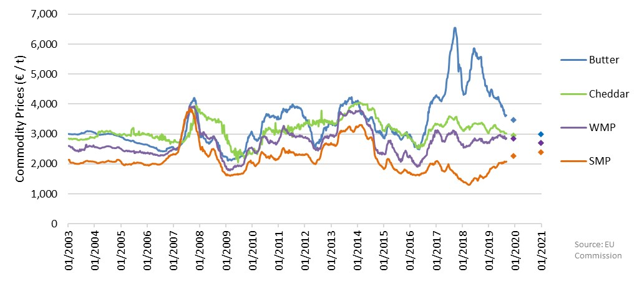
EU Commodity Price Forecasts
SMP+WMP back in line in 2020; weakening across commodity prices
EU Commodity Prices, 2003-2020

Slide 14
What about the EU?

Slide 15
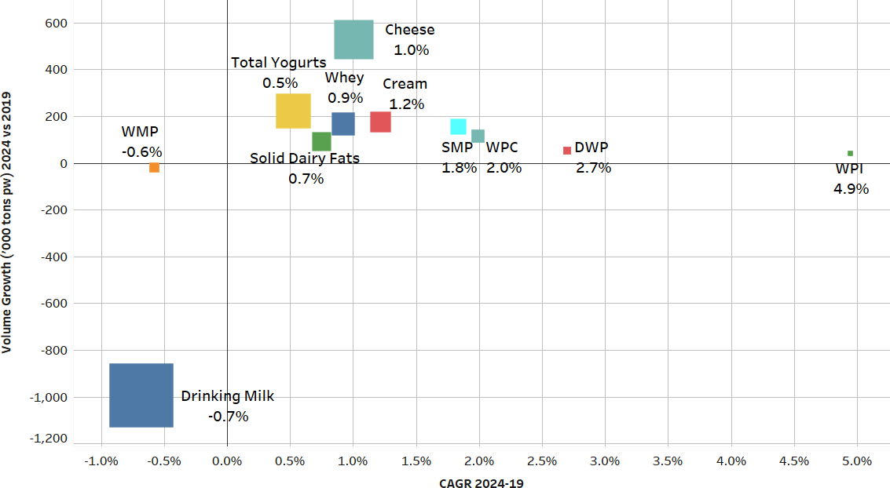
EU Production Growth by Main Product Category
Drinking milk and WMP will decline; robust cheese growth
EU Production Growth, 2019-24
Source: GDC19

Slide 16
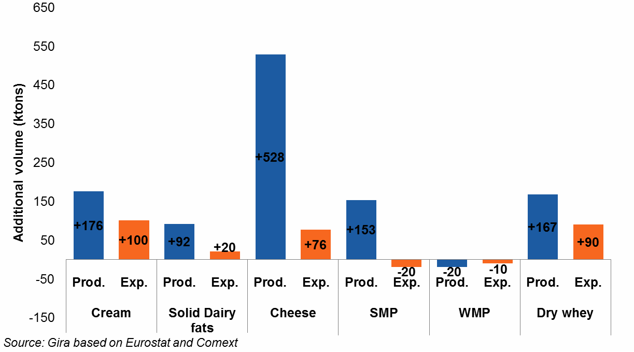
EU: Future Dairy Production & Disappearance
Domestic market to be key sales channel for growth; cream at export
Growth of Dairy Commodities Production and Exports between 2019 and 2024
Cheese in 2020: 10.4 mios tons
+124 ktons compared to 2019
Dairy fats in 2020: 2.4
mios tons
+25 ktons compared to 2019
SMP in 2020: 1.63 mios tons
-60 ktons compared to 2019

Slide 17
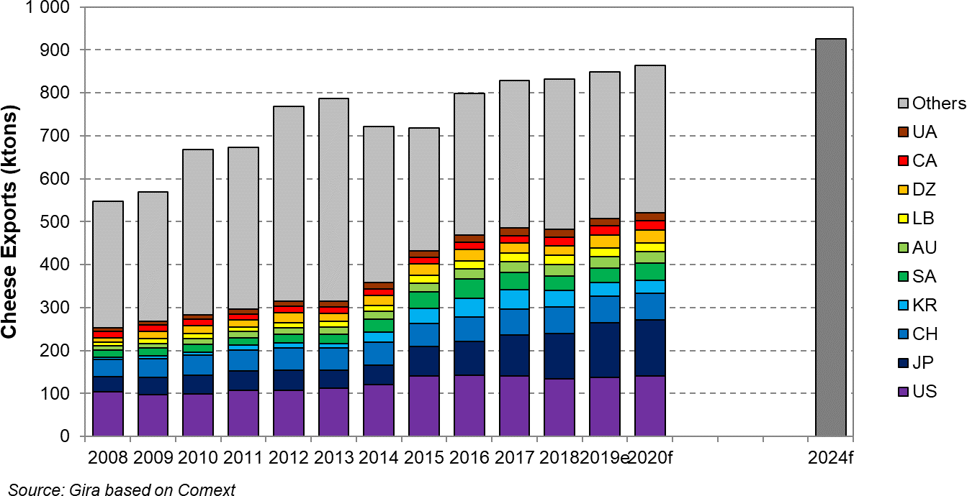
EU cheese exports: 1,7% p.a for the next 5 years (+76’000 tons)
90% of cheese are sold within the EU
EU cheese exports by destination, 2008-2024f (ktons pw)
Total: +1.7% p.a.
Total: +4.3% p.a.

Slide 18
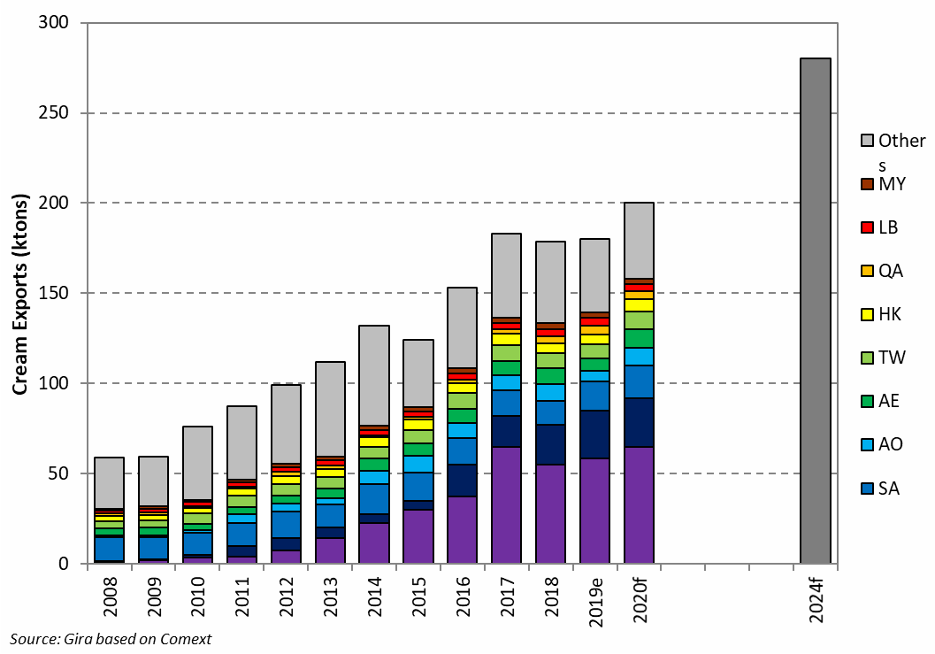
EU Cream exports
Will continue to grow. 9,4% of total EU production will be exported by 2024
EU Cream Exports & Share of Production,
2008-24f
9.4%
7.0%
6.3%
2.4%

Slide 19
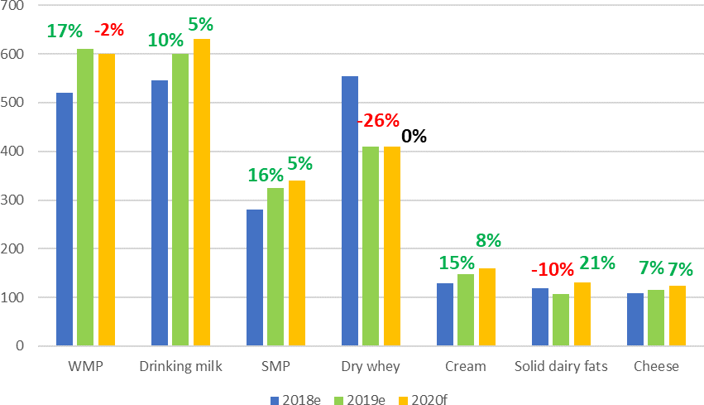
Chinese Dairy Imports: short-term forecast
Generally slower growth expected in 2020 (recovery growth for butter)
Chinese Dairy Products Imports, 18/19/20
WMP: we do not expect higher imports in 2020 than in 2019, with the expected starting recovery of domestic milk production in 2020
SMP: compared to WMP, less linked directly with domestic milk production
Whey: feed whey demand still low; food whey demand growth also impacted by trade war
Solid dairy fats: 2020 recovery after low 2019 imports

Slide 20
So What Might it all Mean?

Slide 21
What we might most usefully bear in mind
Production will continue to grow (but at a lower rate) in the traditional exporting countries.
However, it will never coincide exactly with demand growth. Price volatility will continue
China will continue to be the engine of the growing dairy world consumption, but the EU and the US will also contribute to the growth but until when?
Ensuring it adds maximum value to each litre of milk can only increase in importance for every dairy.
Flexibility will become more and more the name of the game in an inflexible industry
Cheese will continue to attract more milk but which kind of cheese for which application?
Adding value to the whey will become more and more important
Global Attention Turned to Plastic Waste. As an industry, have you got a strategy?

Slide 22

UNEP has forecast that on our current trajectory, there will be more plastic than fish in the sea by 2050. Globally, we have generated 6.3bn tons of plastic waste – only 9% of which has ever been recycled. Some 12% has been incinerated and nearly 80% sent to landfill or simply discarded.
© Gira

Slide 23


Consumer Attitudes to Food Waste (& Packaging)
Sealed Air commissioned research by Harris Poll – European Results
The amount of plastic in oceans
88%
Food waste in my country
74%
81%
The amount of plastic in landfill
80%
80%
Climate change
68%
78%
78%
Over-packaging of food products
60%
76%
76%
Natural resource scarcity
64%
76%
76%
Water shortages/drought
61%
75%
75%
Unreliable food safety/hygiene
64%
2016
73%
Landfill space
59%
70%
2018
The ability to recycle plastic
62%
© 2019 Sealed Air
23

Slide 24
What we might most usefully bear in mind
Production will continue to grow (but at a lower rate) in the traditional exporting countries.
However, it will never coincide exactly with demand growth. Price volatility will continue
China will continue to be the engine of the growing dairy world consumption, but the EU and the US will also contribute to the growth
Cheese will continue to attract more milk but which kind of cheese for which application?
Adding value to the whey will become more and more important
Ensuring it adds maximum value to each litre of milk can only increase in importance for every dairy.
Flexibility will become more and more the name of the game in an inflexible industry
Sustainibility is not any more a buzz word. As an industry, what are you doing?
The non-dairy alternatives will continue to grow and to gain market shares against traditional dairy products (mainly liquid milk and fresh but cheese is starting).
What will be your answer as an industry?

Slide 25
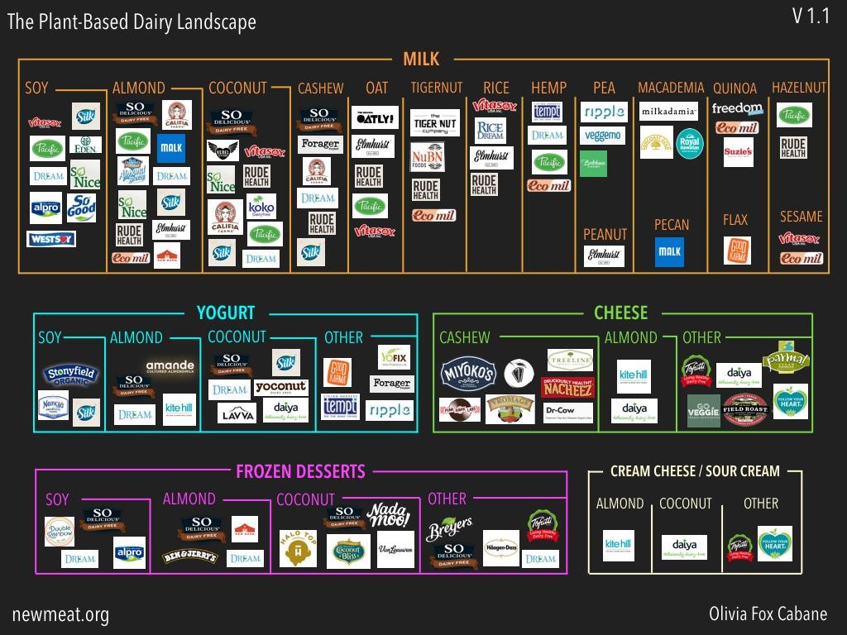
The Plant-based Dairy Landscape in January 2018
A vast number of brands but some producers already in many segments

Slide 26
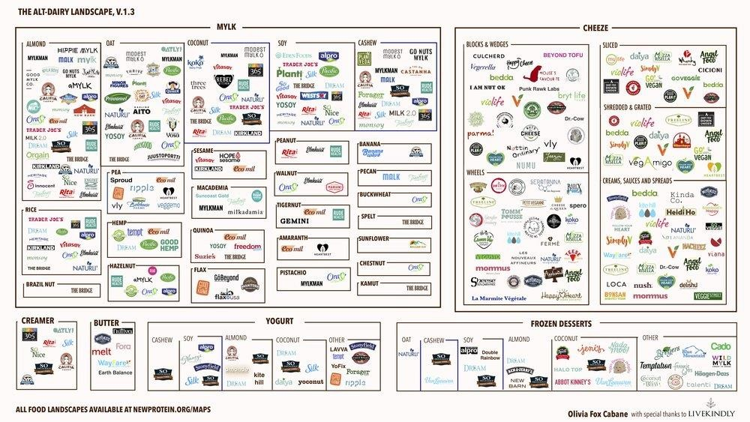
The New Dairy Landscape in January 2019
A really fast growing market

Slide 27
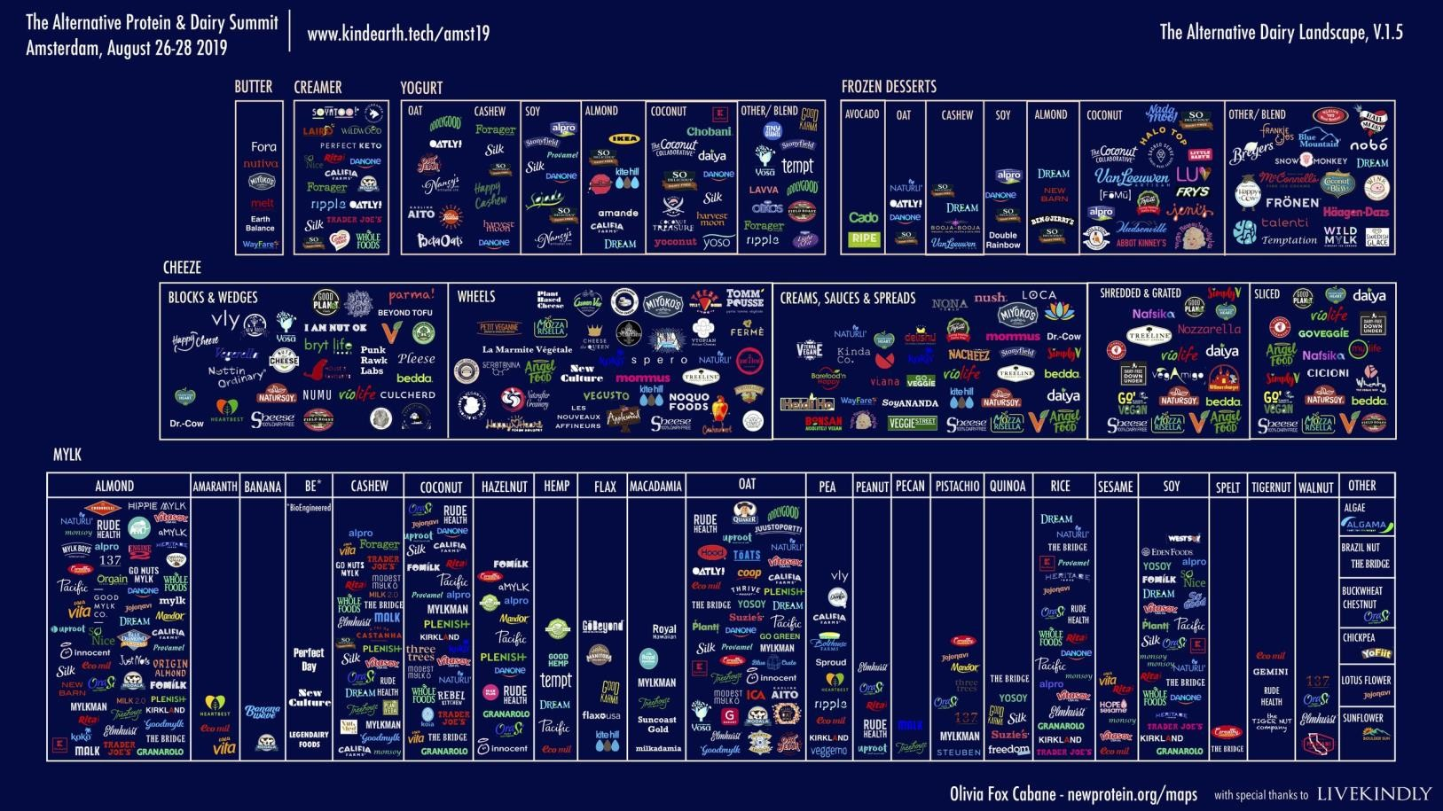
The New Dairy Landscape in June 2019
A major threat for our industry. What will be your strategy?
Non-dairy alternatives are growing for cheese
What will be your answer as an industry?

Slide 28
Thanks a lot for your attention
Should you require more information, please contact Christophe Lafougere
clafougere@girafood.com

