Slide 1

“The Netherland’s vision on agriculture – transition to circular agriculture” – with special attention to the diary sector
Jasper Dalhuisen

Slide 2
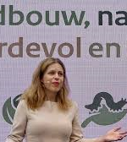
Content
Short Introduction to the Netherlands
Short history of the development of the Agricultural- and Horticulture sector
The Dutch Agriculture- and Horticulture sector
The Dutch Diary Sector
Circular Agriculture
Co-operation is the key! The Dutch AKIS system
The future challenges
Questions?

Slide 3
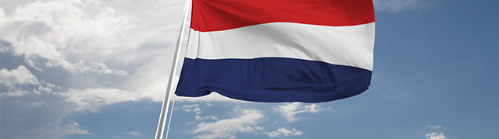
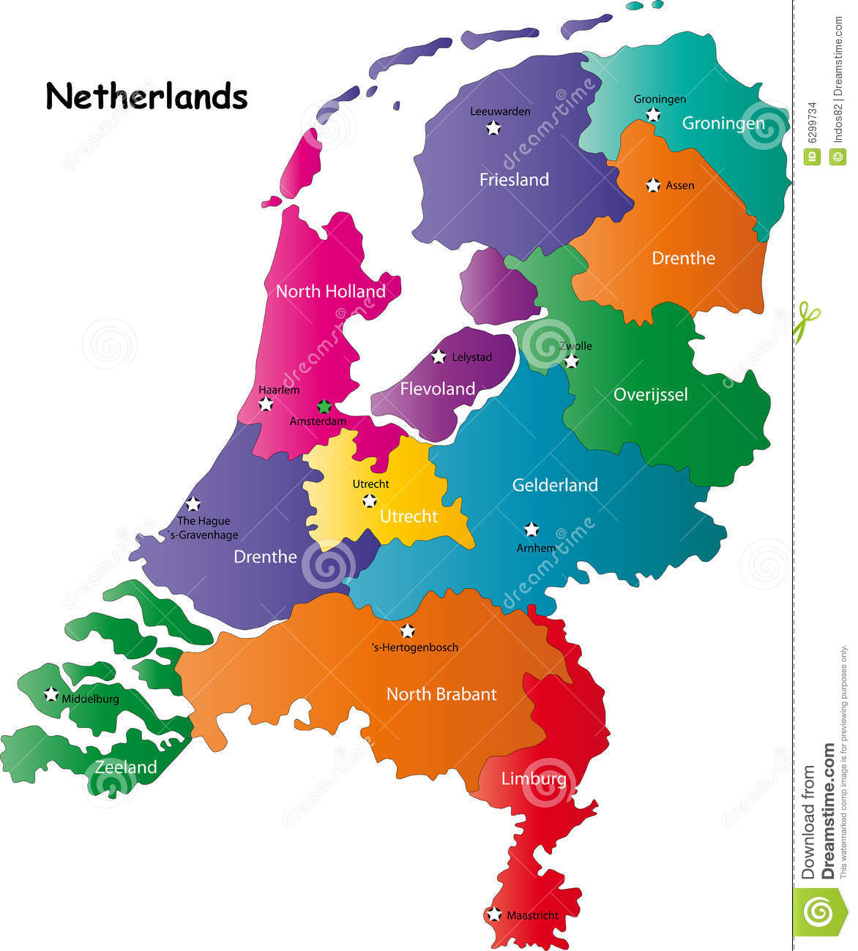
Surface: 33.783 km² (no water area included)
Population: 17,181,084 people (date 1/1/2019)
Population density: 510 people/km²
Number of farms (2018): 53,906 (97,389 in 2000)
Number of cattle (2018): 3,690,000
Number of pigs (2018): 11,934,000

Slide 4
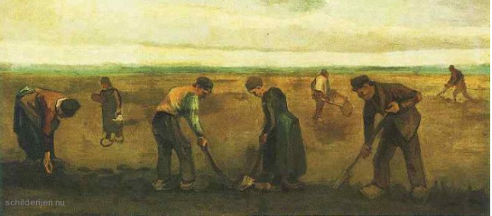
Vincent van Gogh, Nuenen, 1884

Slide 5
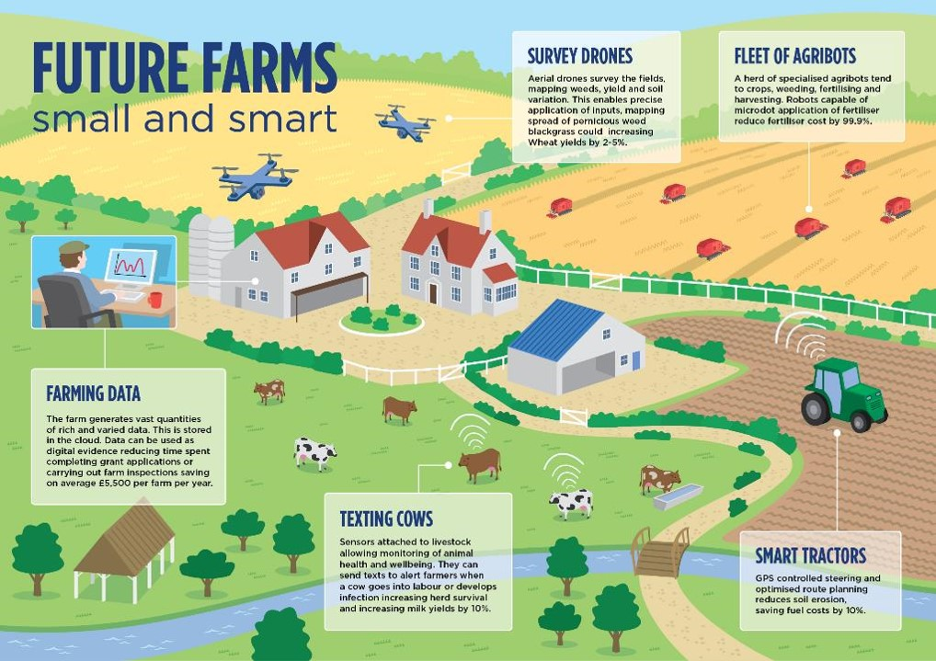
Notes:
Plaatje is in Engeland gemaakt: Herkomst onduidelijk. Maar geeft een mooie visueel overzicht / samenhang van technologie en gemengd bedrijf
Textbox 1 Farming Data : The Farm generates vast quantities of rich and varied data. This is stored in the cloud. Data can be used as digital evidence
reducing the time spent completing grant applications or carrying out form inspections saving on average 5500 pounds per year
Textbox 2 Texting Cows : Sensors attached to livestock allowing monitoring of animal health and welbeing. They can send texts to alert farmers when a cow gets into labour or develops an infection. Increased herd survival and increaded milk yields by 10 % (?)
Textbox 3 Survey Drones : Aerial drones survey the fields , mapping weeds , yield and soil variation. This enables precise application of inputs, mapping spreads of pernicious weed blackgrass. Could increase wheat yields by 2 – 5 %
Text box 4 : Fleet of Agribots : A heard of specialised agribots tend the crops, weeding, fertilising and harvesting. Robots capable of microdot application of fertiliser, reduce fertiliser loss by 99.9 %
Textbox 5 Smart tractors : GPS controlled steering and optimised route planning reduces soil erosion saving fuel costs by 10 %

Slide 6
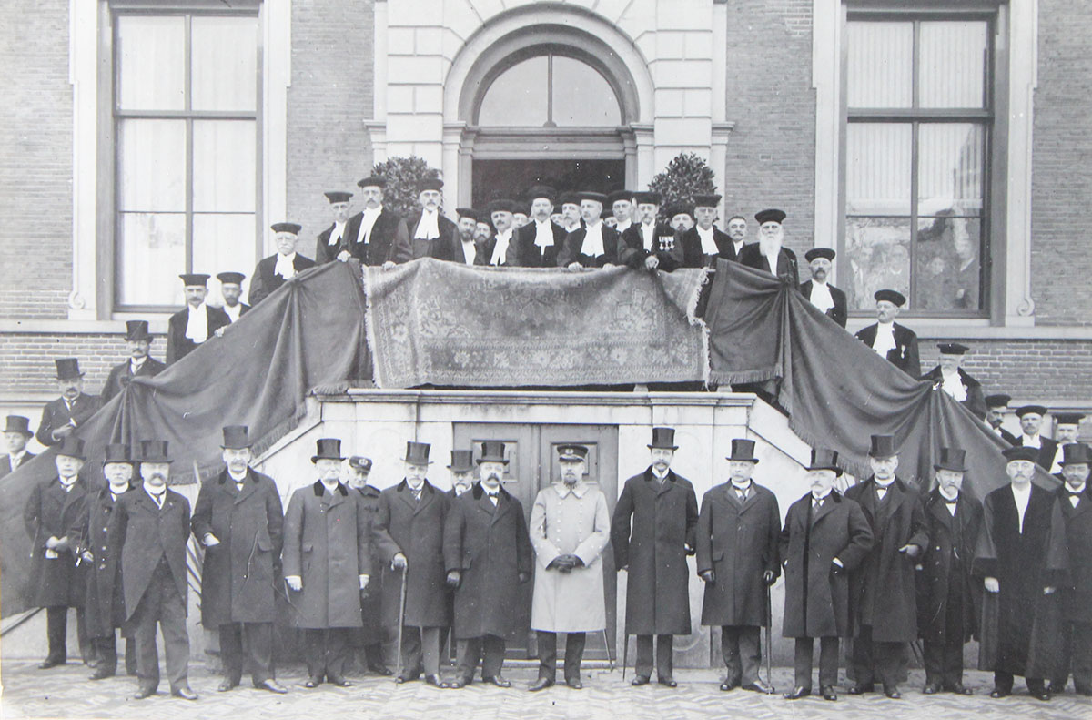
The success of Dutch agriculture started in 1880!
State committee with an advice to improve agriculture
Agriculture research, extension services and education
Increase the knowledge base of the sector to have:
a competitive agricultural sector (land=scarce, labor expensive)
A wide range of unique products
An efficient and innovative agriculture (inputs, infrastructure, meeting demands of consumers)
Establishment of agricultural knowledge institutes: Wageningen

Slide 7
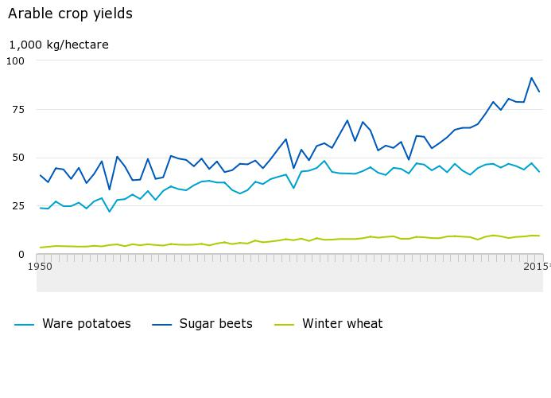
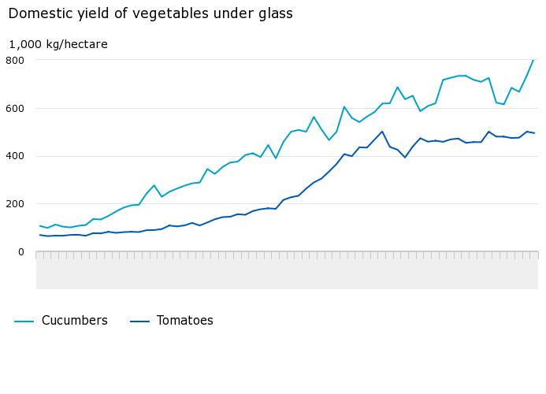
Dutch agriculture and horticulture: productive!
The production value of agriculture in the Netherlands increased.
Intensification and scaling-up accounted for the strong growth in both agricultural output and productivity
The area covered by an average holding was around 5.7 hectares in 1950, versus 32.4 hectares in 2016.

Slide 8
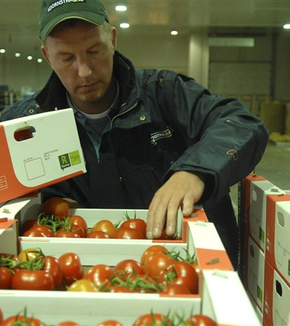
Dutch agriculture international oriented
The export of agricultural goods is estimated at 90.3 billion euros in 2018
The second largest exporter of agricultural goods in the world.
70% of the production is exported, also a high share of re-export in the Netherlands

Slide 9
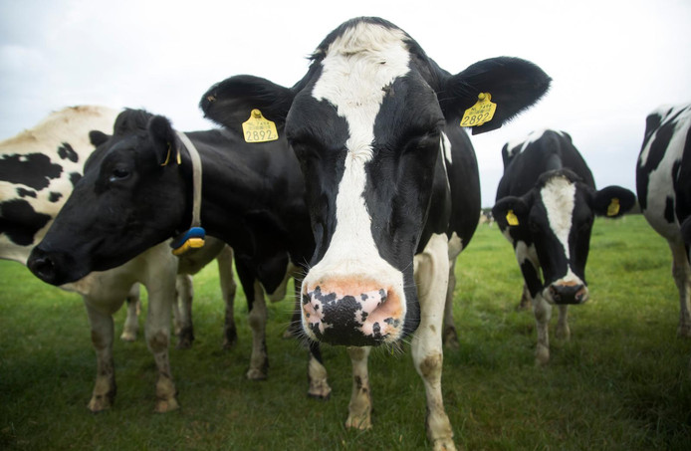
The Dutch Diary Sector

Slide 10
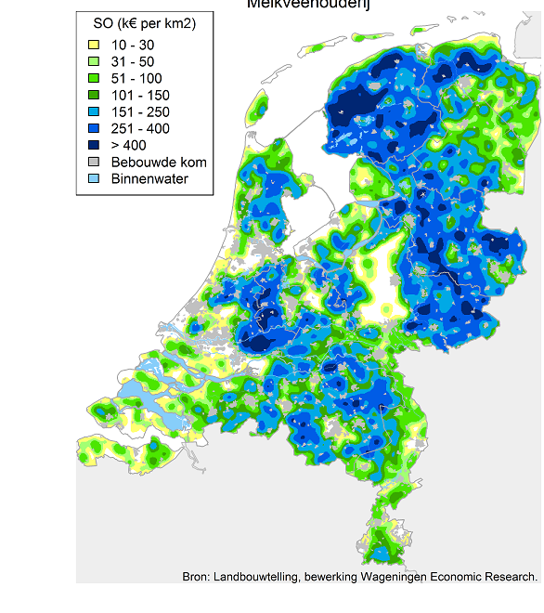
Nearly half of agricultural land used for dairy farming
Clusters in which dairy farming is economically dominant are quite sizeable
located in the provinces of Utrecht, North Holland, South Holland and Friesland as well as in the southern and eastern parts of the Netherlands.

Slide 11
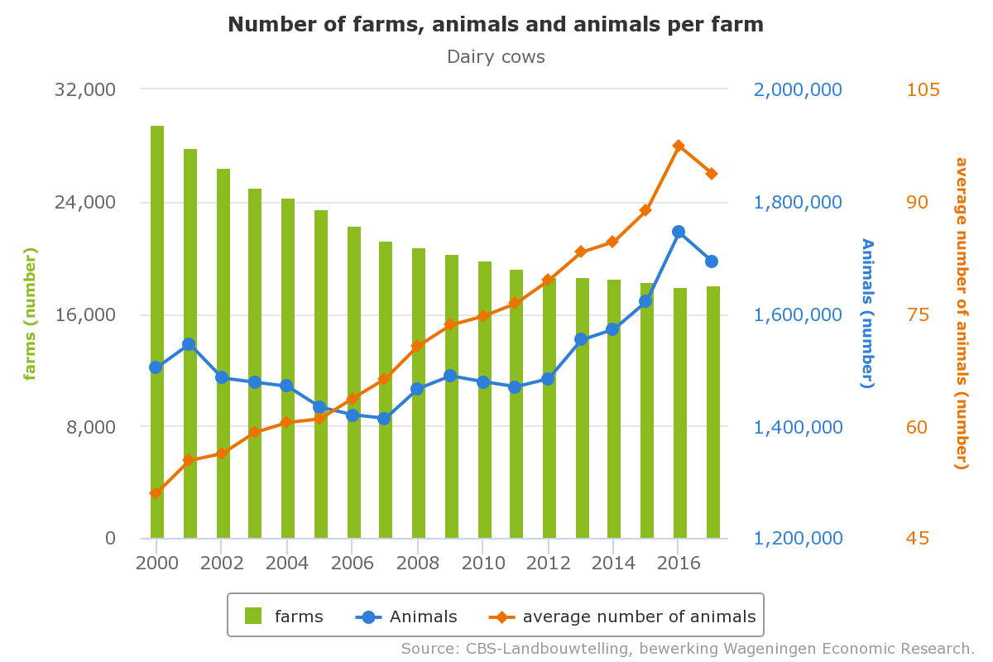

Slide 12
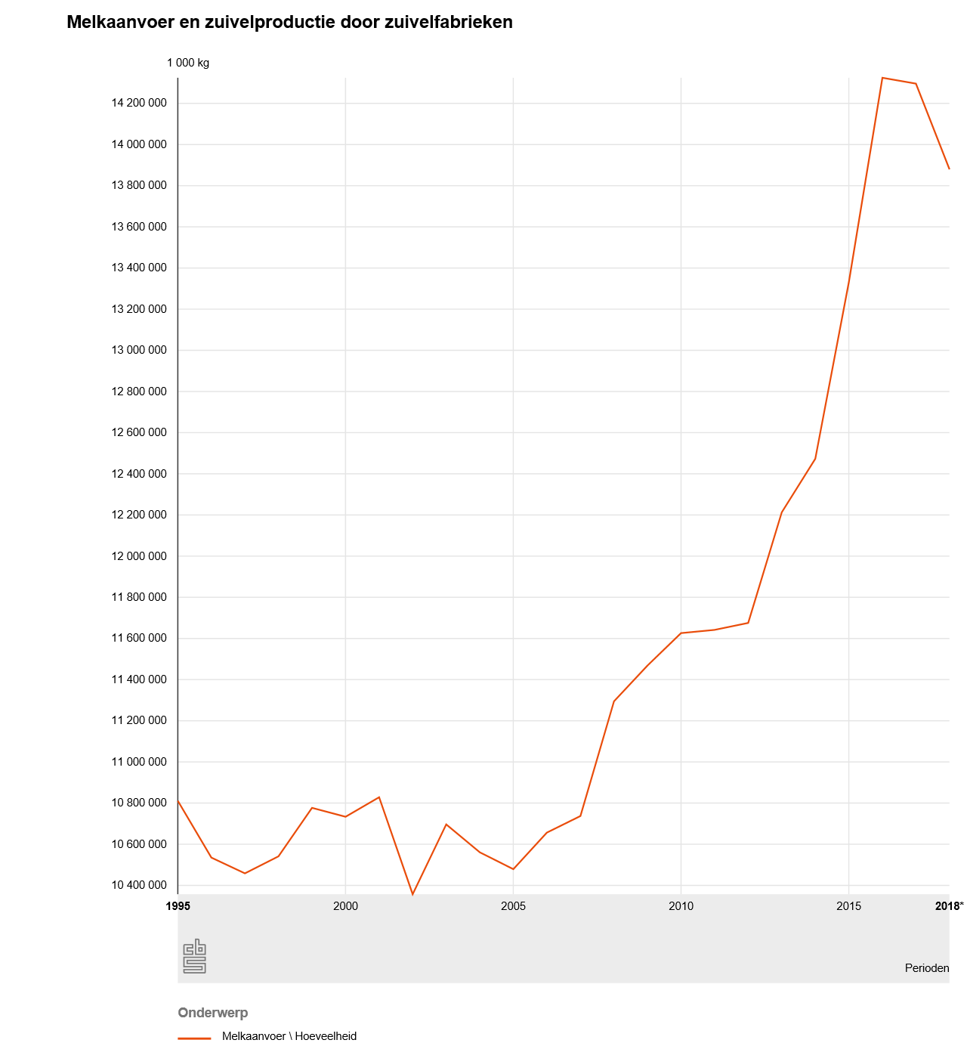

Slide 13
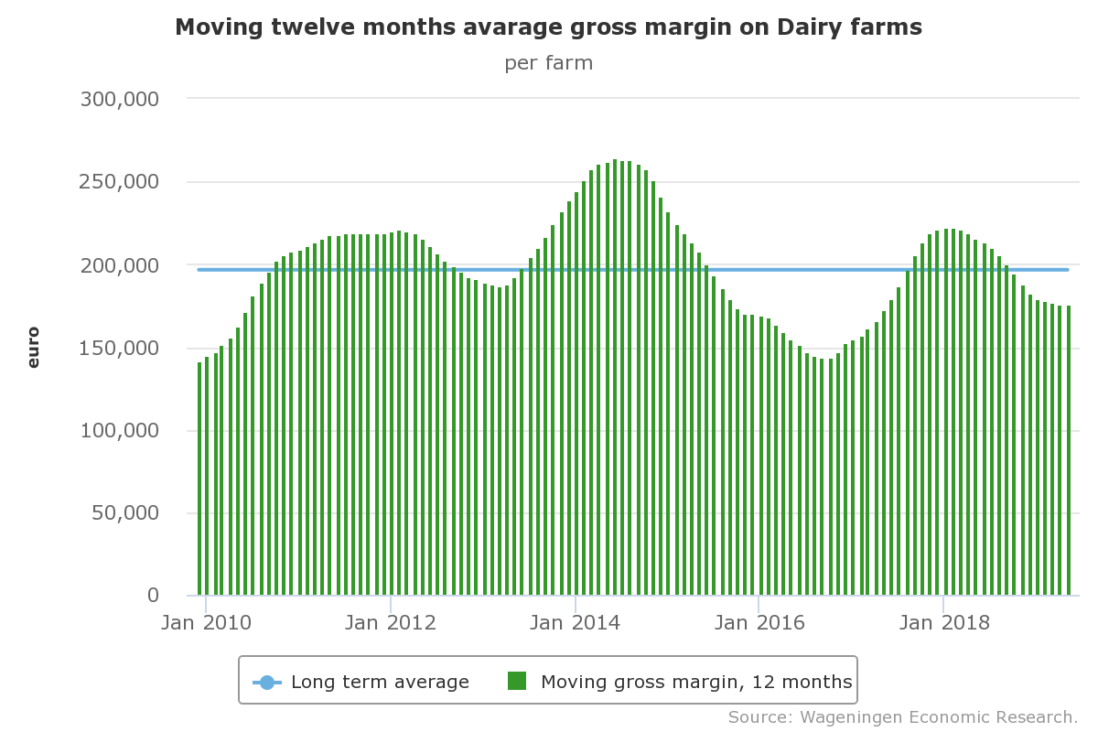

Slide 14
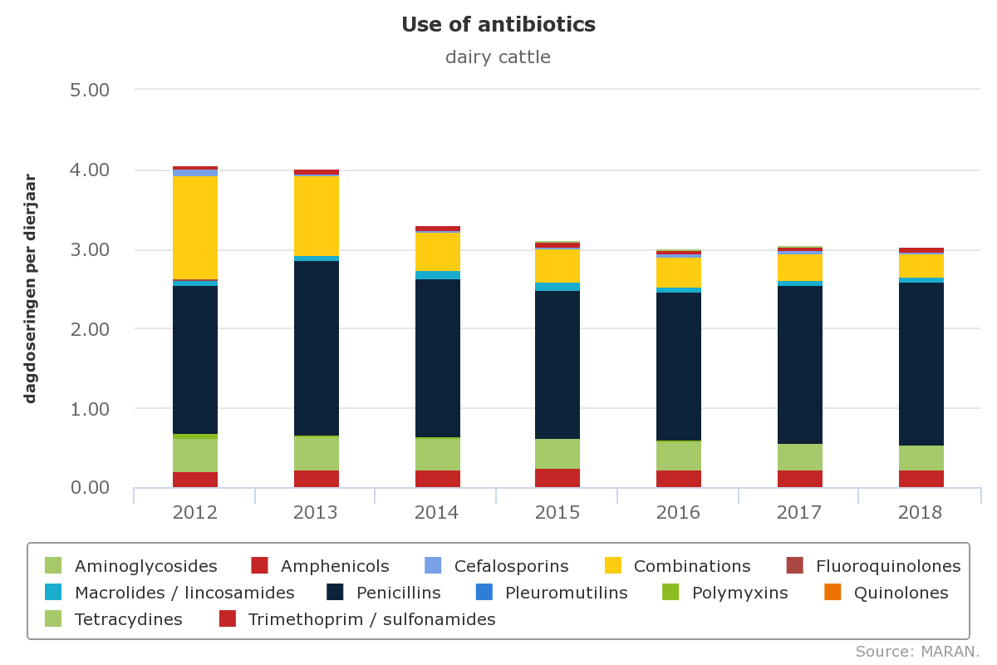

Slide 15
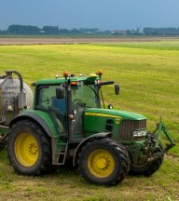
Intensive high productive farms: side effects
Large-scale uniform landscapes
High levels of manure and of fertilizer and pesticide consumption
Large numbers of animals were housed in increasingly dense environment
Loss of biodiversity

Slide 16
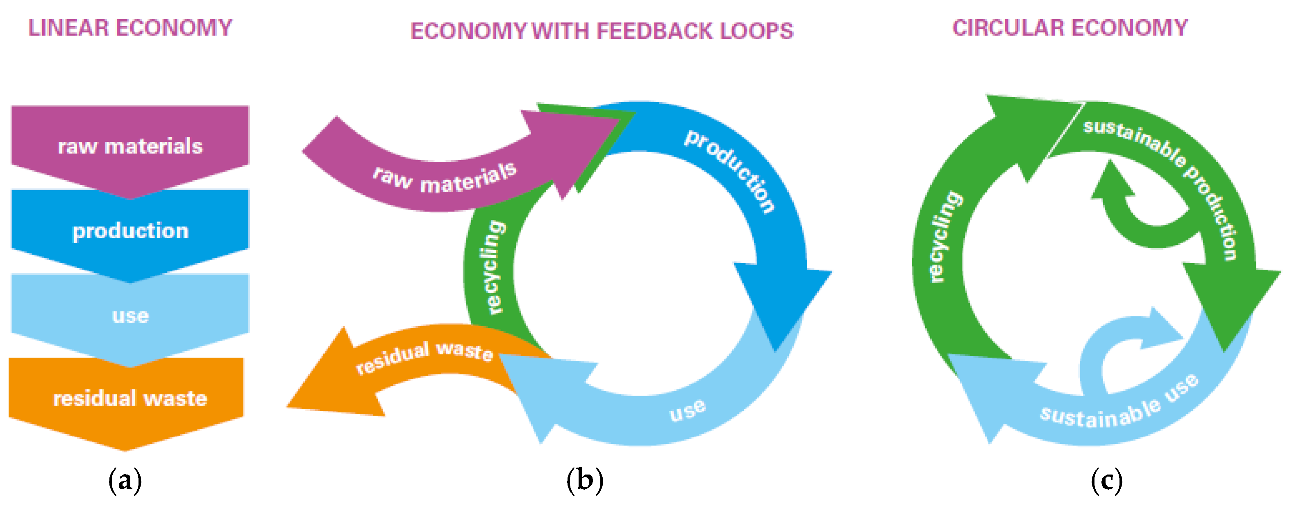
Agriculture, nature and food: valuable and connected.
The Netherlands as a leader in circular agriculture
Do it locally if you can, and regionally or internationally if you have to.

Slide 17
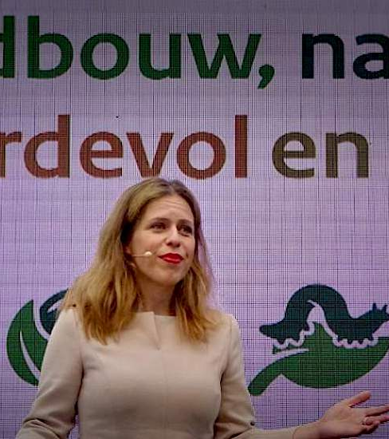
Agriculture, nature and food: valuable and connected. The Netherlands as a leader in circular agriculture
Global player, but current production methods are not without cost. The Netherlands faces serious social and ecological challenges.
The Netherlands needs to prevent depletion of soil, freshwater supplies and raw materials, halt the decline in biodiversity and fulfil our commitments to the Paris climate agreement.

Slide 19
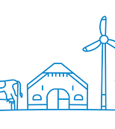
Sustainable Challenges
The Sustainable Dairy Chain (Duurzame Zuivelketen)
Protecting biodiversity and the environment
Preservation of grazing
Continuous improvements in livestock health and welfare
Climate neutral development

Slide 20

BIN
1500 companies from the Dutch agricultural- and horticulture sectore
Particpants can benchmark themselves with comparable companies

Slide 21
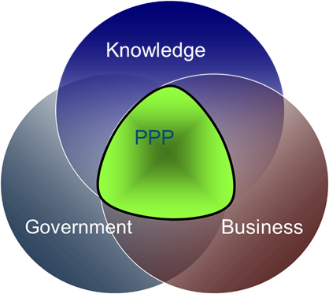
Cooperation is the key! The Dutch triple helix
Topsector (TS) policy: Agri & Food, and Horticulture and starting materials
Numerous public private partnerships (ppp) and projects
Cross-overs with TS Life sciences, Water, Energy, High tech systems and Materials, Chemistry
Demand driven, integrated approach, cross-sectoral
Several schemes to promote innovation activity, mostly targeted at SMEs
TKI allowance, SME+ innovation fund, SBIR, etc.
Operational Groups (EIP) AGRI: managed by the regional Provinces

Slide 22
Knowledge institutes and government (1/2)
Knowledge institutes (education and research)
Wageningen University and Research (education, fundamental and applied research)
4 Universities of applied sciences (HBO)
13 Institutes for Vocational Education
Research institutes: e.g. WUR, TNO, RIVM, NIZO (dairy), IRS (beets), Delphy, (other) private research and consultancy firms, R&D facilities from 12 of the global top 40 food and beverage companies

Slide 23
Knowledge institutes and government (2/2)
Government (role in the governance of the AKIS)
Ministries ANFQ, EAC, ECS, HWS, IWM
Correction of market failures: organise the AKIS, pooling of capacity, funding/governing of public goods, etc.
ANFQ: e.g. contract research and public inspection (NVWA)
ECS: governs agricultural education
Growing role EU – but EU-agenda is not always aligned with national and regional agendas

Slide 24
Intermediates and the sector
Intermediates
Farm Advisory System: 40 private advisory firms
Elaborate network of (informal) farmer study groups (farmer driven)
- extension services were privatised in the 90s
The food and agricultural sector > primary actors in innovation (farmers, food industry, supplying industries)
LTO Nederland (federation of the sector, consultants advising entrepreneurs in the sector)
The Dutch AKIS is changing
Into an increasingly complex system with changing roles and topics
From a linear to a more dynamic, interactive and diversified innovation network system approach
changing role of government e.g. topsector policy, triple helix

Slide 25
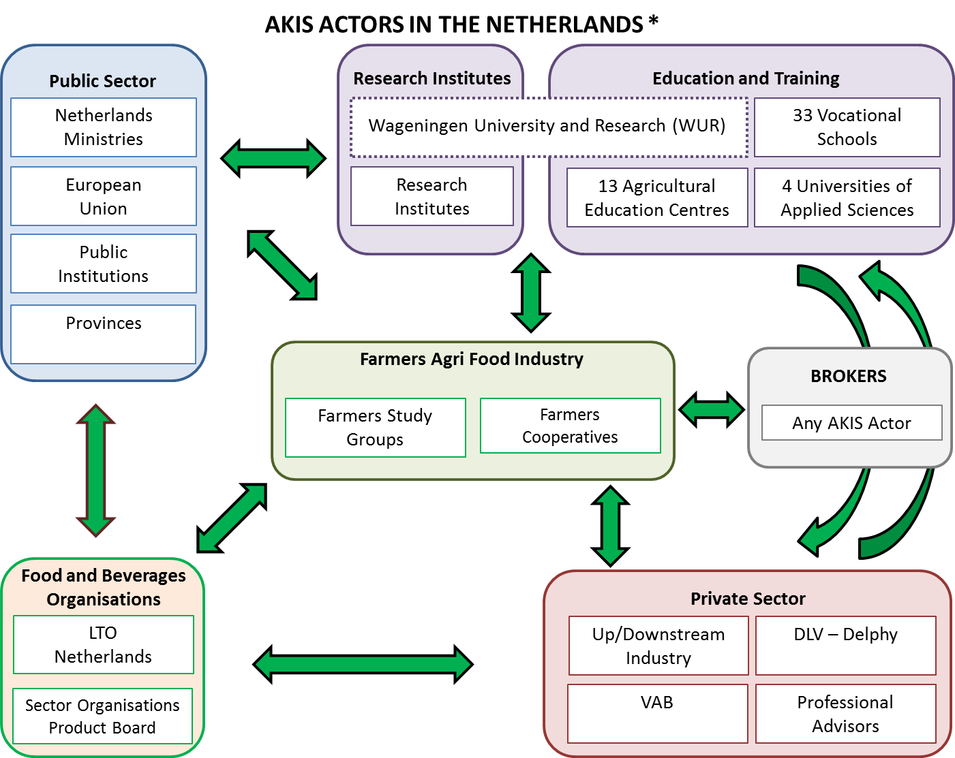
Overview AKIS’ actors

Slide 26
Main changes from 2012
Sectoral changes (large scale firms, intensification) -> more ability for private R&D investments but larger gap with SMEs
Transition of knowledge as a public good to knowledge as a marketable product on a worldwide market
The Dutch AKIS is under pressure e.g. by cuts in public funding
Need for linking a variety of scientific and technological disciplines – real challenge of innovation itself
Continuing internalisation of the AKIS (EU and globally) – actors and knowledge flows

Slide 27
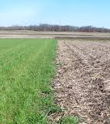
The way ahead
Making a vision to 2030 more concrete!
Promoting the vision in Brussels (CAP)
How to reconcile circularity with the Dutch being the second exporter of the world
Role of the government
Circularity as a business model

Slide 28
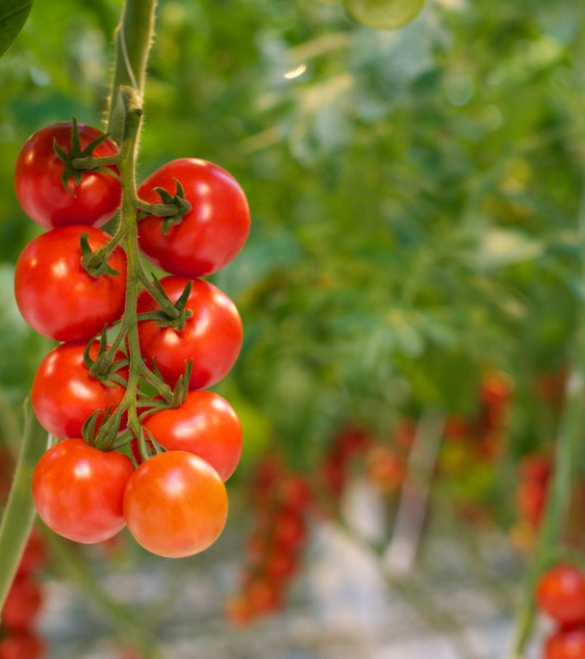
Thank you!
Questions?
j.m.dalhuisen@minlnv.nl

