Slide 1
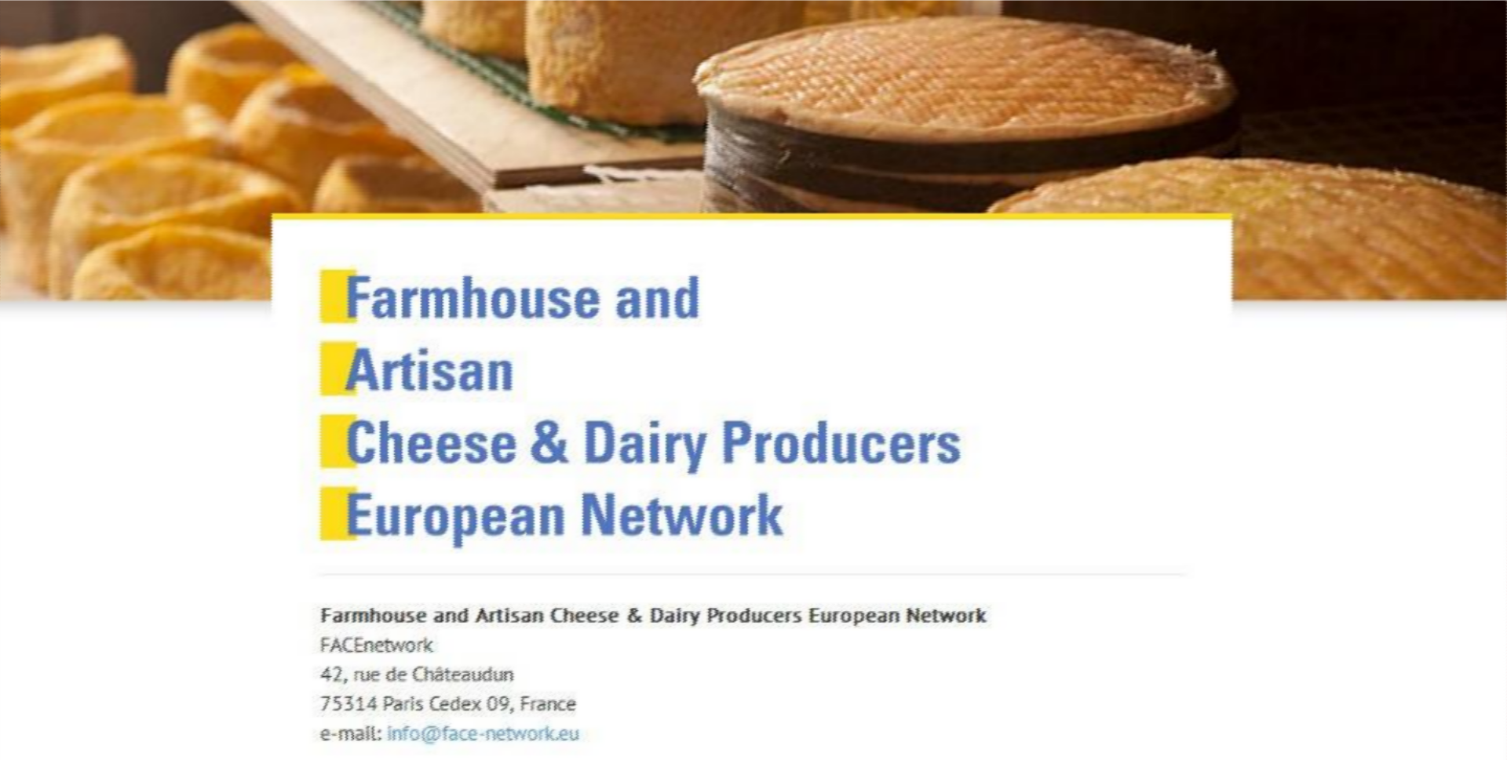


Slide 2
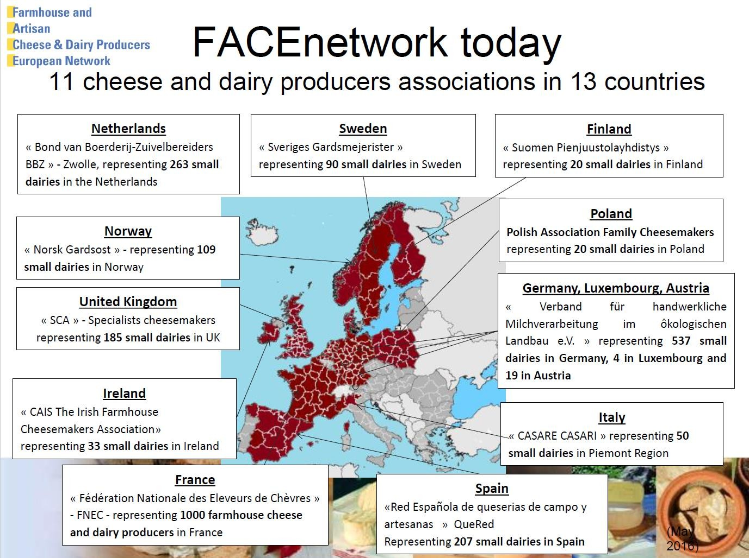

Slide 3
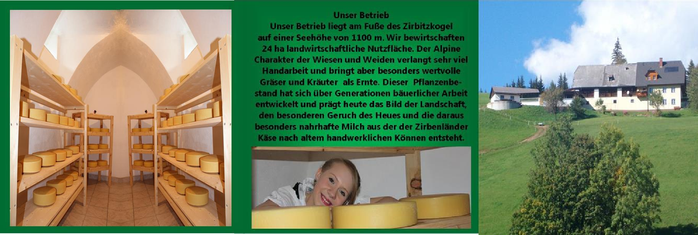


THE PLACE OF SMALL SCALE PRODUCER IN THE SUPPLY CHAIN IN AUSTRIA
Experiences and Ideas of producing farmhouse milk products in Austria
www.milchhandwerk.info
Verband für
handwerkliche Milchverarbeitung
Karl M. Fraißler
Small Scale Farm Dairies Conference 2019 Rakvere AQVA Conference Centre
Estonia

Slide 4
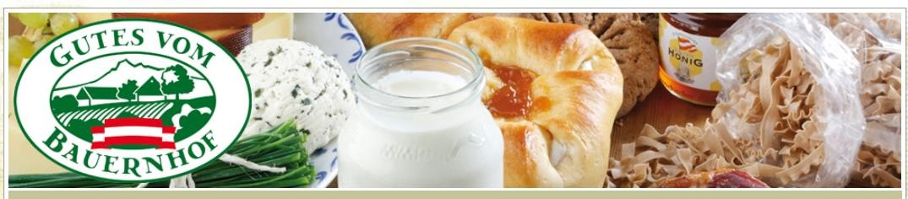
The most important Points in Summary:
Importance of Direct Marketing for Austrian Farmers
Products & Distribution Channels for Direct Marketing
Jobs in Direct Marketing
Future Development of Direct Marketing
Consumers have (need) Motives
Who buys organic Food

Slide 5
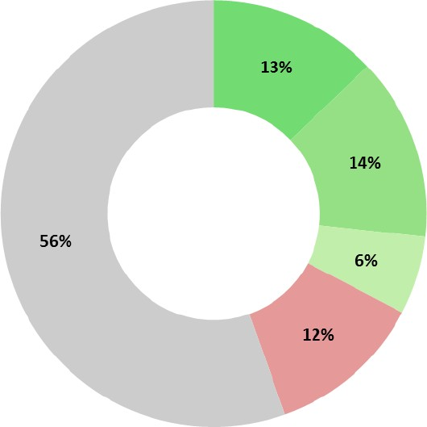

Situation of Direct Marketing in Austria
135,000 farms with more than 5 ha
horticulture, vegetable gardening and viniculture also less than 5 ha
Number of farms:
Intensive DM Extensive DM Potential Newcomers Dropout Disinterested
27% of the Austrian farmers are active in Direct Marketing 73% of farmers are currently not active in Direct Marketing

Slide 6
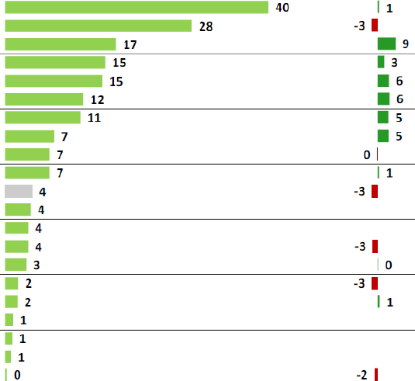
Products in Direct Marketing in Austria
Percentage
Meat and meat products Milk and milk products
Wine Eggs
Fruits and fruit products
Fruit juice
Spirits Cereals and cereal products Bread and baked goods
Vegetables
Others Potatoes Poultry
Oils beekeeping products Wood/fuelwood
Must Herbs
Breeding animals
Hay
Fish

Slide 7
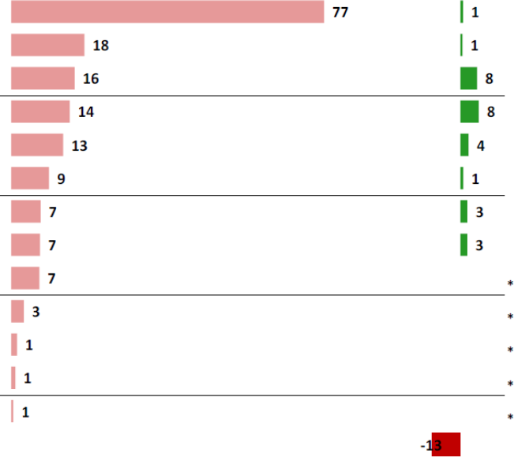
Distribution Channels
in Direct Marketing in Austria
Retail from the farm house as the most important DM distribution
channel
Farm house retail Delivery service Gastronomy Food retail
Farmer's market/market
Retailer partnership/Farmhouse shops
Heuriger/Buschenschank
Internet Christmas market/wine shop etc. Dairy/cooperative/association Private/neighbours/friends
Fair Food Coops
Others

Slide 8


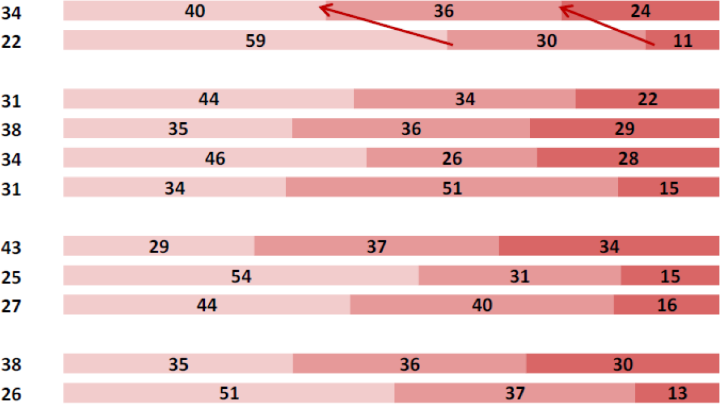
Income from Direct Marketing in Austria
The part of income from direct marketing is increasing
Average
until 10% of income
until 50% of income
until 100% of the income
Total 2016
Total 2010
Until 34 Years
35 to 44 years
45 to 54 Years
55 and older
Until 20 ha
21 to 50 ha
51 ha and more
Full time farming Part time farming

Slide 9

Worker in direct marketing in Austria
Direct Marketing brings Jobs in rural Areas
Worker | Without DM | With DM | Difference
Full time (Factor 1) | 1,10 | 1,70 | 0,60
Part time (Factor 0,5) | 0,20 | 0,40 | 0,20
Marginal (Factor 0,25) | 0,08 | 0,15 | 0,08
Full-time equivalent | 1,38 | 2,25 | 0,88
Extrapolated to total Austria, direct marketing thus creates around 31,000 jobs on Austria's farms.

Slide 10
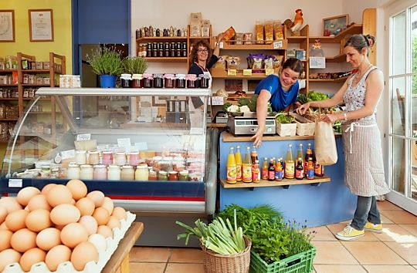
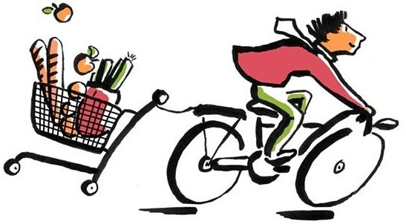
Future Development of Direct Marketing in Austria
Distribution Channels in Direct Marketing in Austria
Directly from the farm
Internet !!!!!
Delivery service
Farmhouse shops
Farmer`s market
(Gastronomy, Food retail)
The main Reasons for the increasing Direct Marketing in Austria
Strong demand from the consumer
Increased sales activities
Extended product range

Slide 11
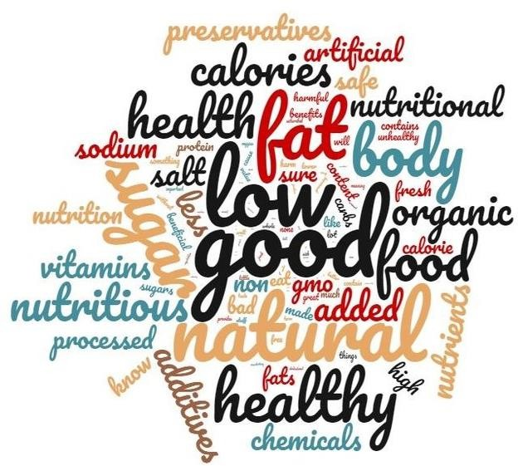
Consumers have Motives
THE PLACE OF SMALL SCALE PRODUCER IN THE SUPPLY CHAIN

Slide 12
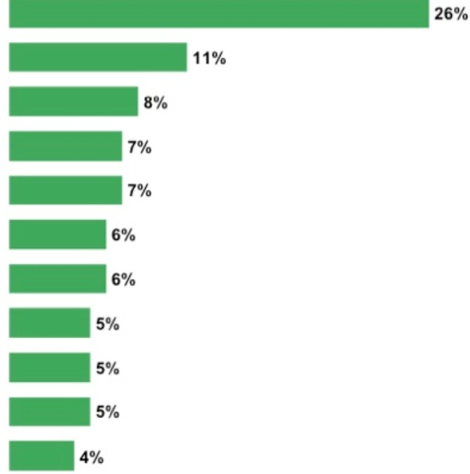
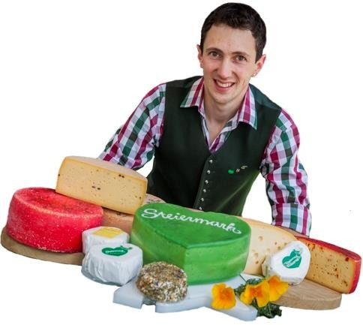
Consumers need Motives
THE PLACE OF SMALL SCALE PRODUCER IN THE SUPPLY CHAIN
Health, healthy, healthier, for health reasons Taste, better in taste, tastes better Environment, friendly, compatible, healthy
healthy foods, healthy food
Quality, good quality
Price € No herbicides, no fungicides, no pesticides
no toxins, pollutant-free
natural, pure natural, natural products no chemistry, without chemistry Austrian products, regional products
RollAMA, 2008

Slide 13

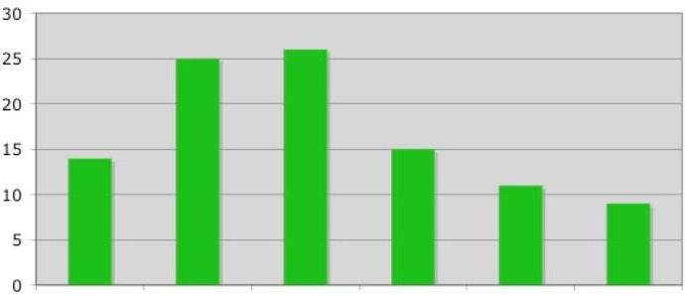
Who buys organic Food in Austria
THE PLACE OF SMALL SCALE PRODUCER IN THE SUPPLY CHAIN
young singles
young families without a child
young families with a child
young families with older children
older families
older singles
RollAMA, 2008

Slide 14
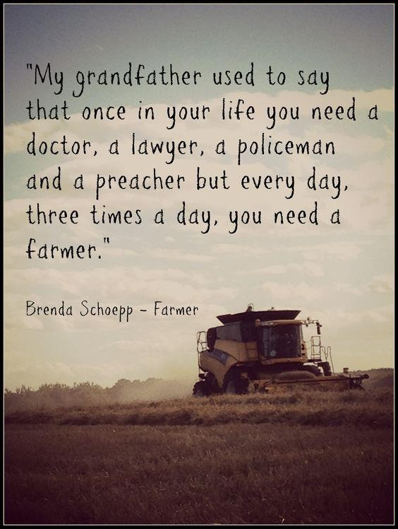

Foodprint

Slide 15
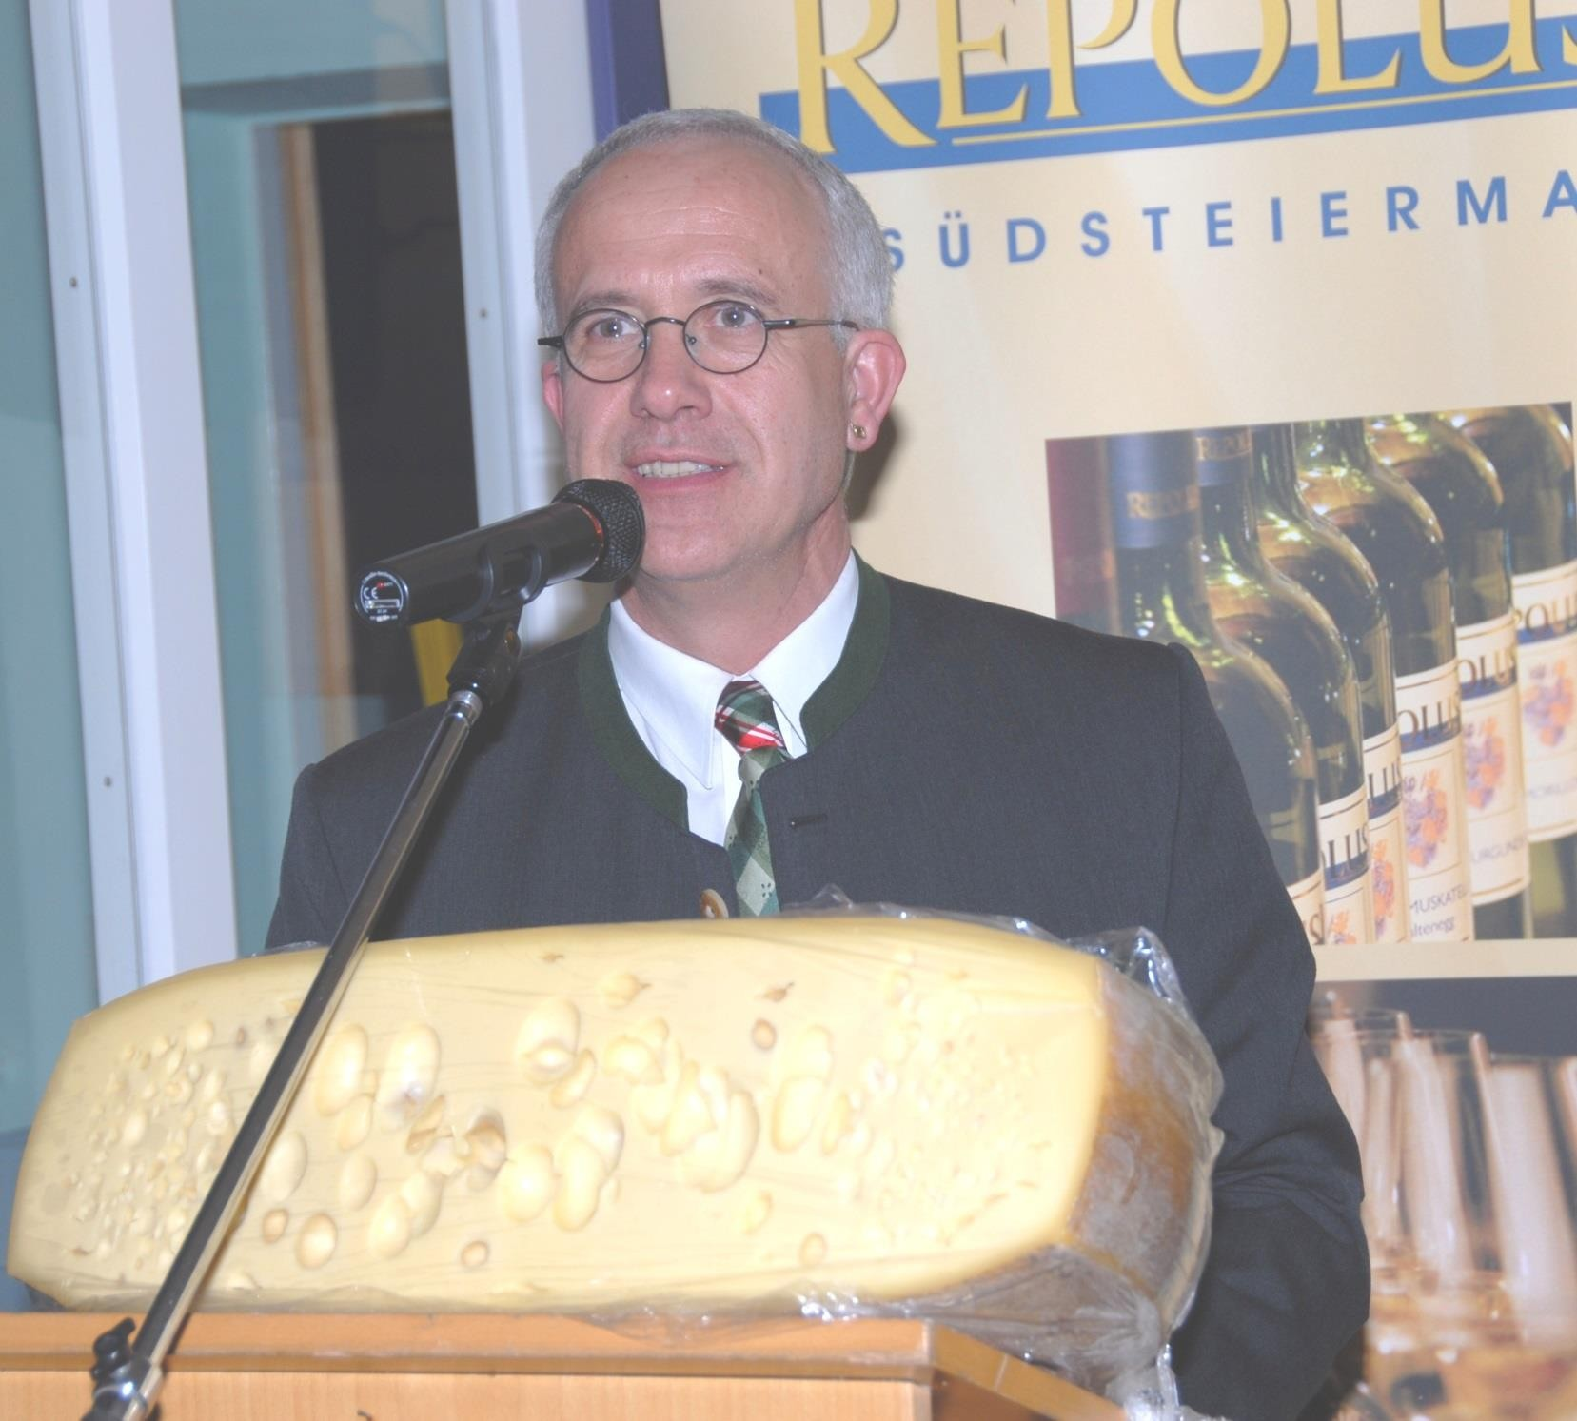


Thank you and God bless your doing
Karl M. Fraißler

