Slide 1
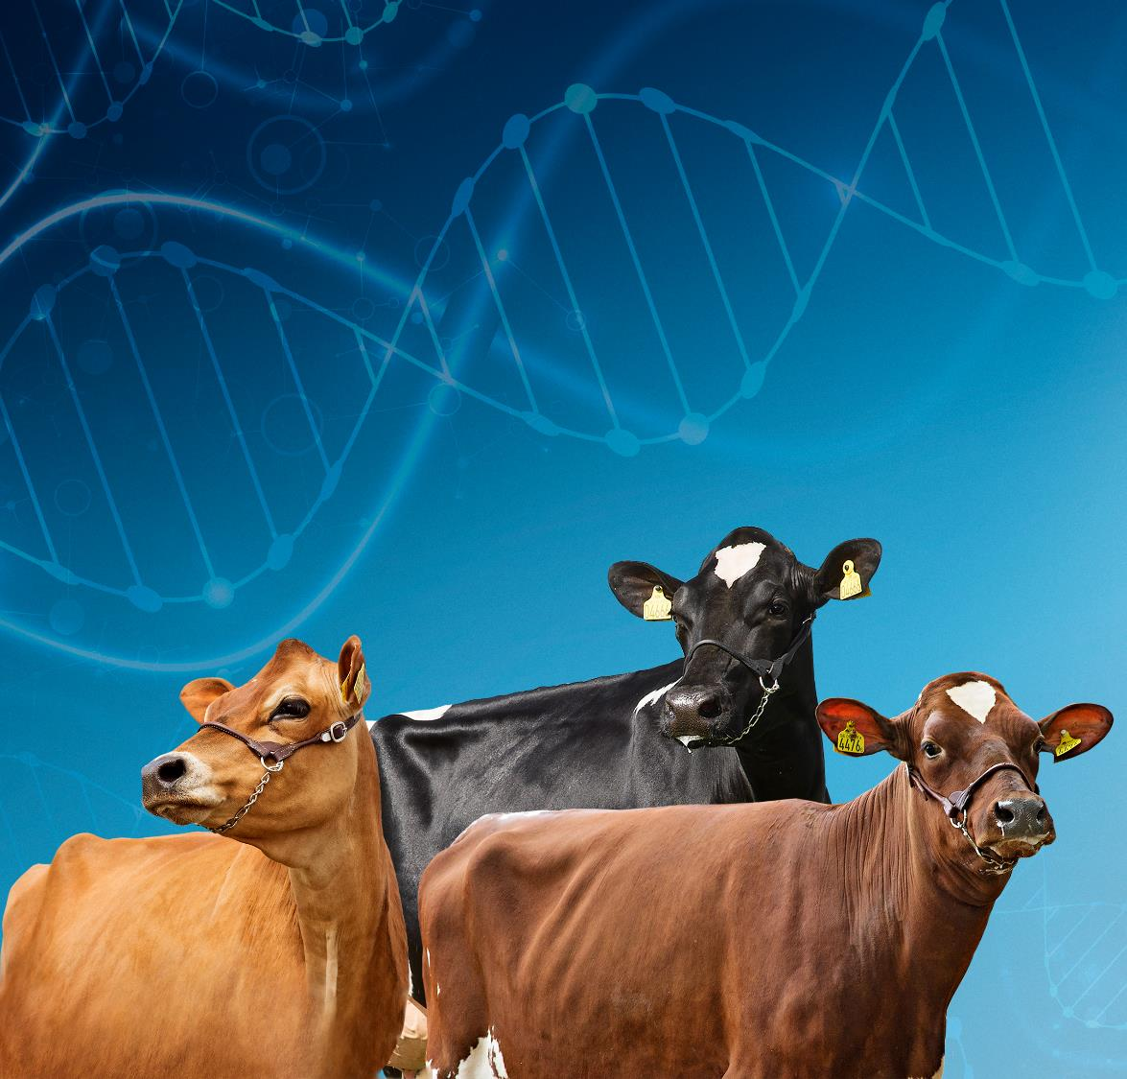

Dairy Cattle Breeding today and tomorrow Why Viking ?
Lars Nielsen
Chief Breeding & Production Officer

Slide 2
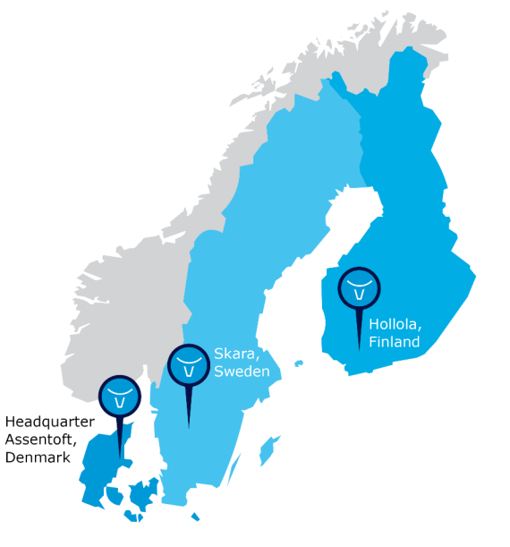






VikingGenetics
Owned by 22,000 cattle farmers in Denmark, Sweden and Finland
Daughter companies in:
Australia
United Kingdom
Germany

Slide 3
Dairy cattle production in the Nordic countries
90% of dairy cows in registration system
High management level
Very high production per cow
Large focus on health traits in breeding
Strict regulations regarding use of antibiotics and hormones
Sustainability, food safety & animal welfare in the whole value chain

Slide 4
Viking Focus
Needs for dairy cattle farmers
Profit
Easy, fertile and healthy cows
Easy and clear solutions
Respect we are producing FOOD

Slide 5



International consumer trends
UN Sustainable Developement Goals
Limit increase of temperature
Specific reduction targets 2030
Climate neutral i 2050
New CAP-regulation
Animal welfare
Antibiotic resistance

Slide 6



Handle antibiotics with care
Animal health
Animal welfare
Public health
Food security
THIS IS A GLOBAL PROBLEM – JOINED EFFORTS ARE NEEDED!

Slide 7

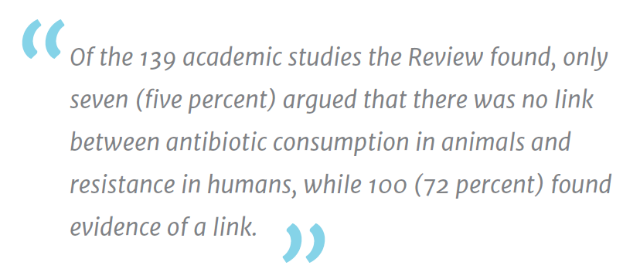
Responsible use of antibiotics
Antibiotics are used for disease prevention, treatment and in some countries also for growth promotion
Raising concern globally
>20%
Animal production losses are caused by diseases globally
human pathogens are of animal origin
Antibiotics used in animals are medically important for humans
75%
>60%
THE REVIEW ON ANTIMICROBIAL RESISTANCE (2015)
7

Slide 8


Use of anitibiotics in cattle production in EU
Viking countries have the lowest use by far of antibiotics in livestock in Europe and the world.
Sales in mg/PCU is weighted according to the proportion of cattle among all food-producing animals in EU member states that have > 200,000 tones PCU for Cattle.
Source: European Medicines Agency, European Surveillance of Veterinary Antimicrobial Consumption, 2016. ‘Sales of veterinary antimicrobial agents in 29 European countries in 2014’

Slide 9
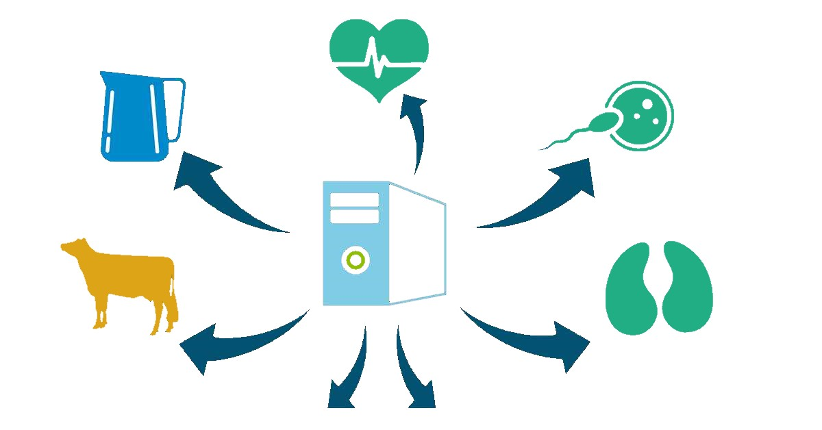
Reliable breeding values – DATA
Health data
90%
Milk recording
95%
Fertility data
100%
Classify the whole herd
50%
Electronic hoof trimming data
35%
RELIABLE BREEDING VALUES
BEST HERD MANAGEMENT TOOL

Slide 10

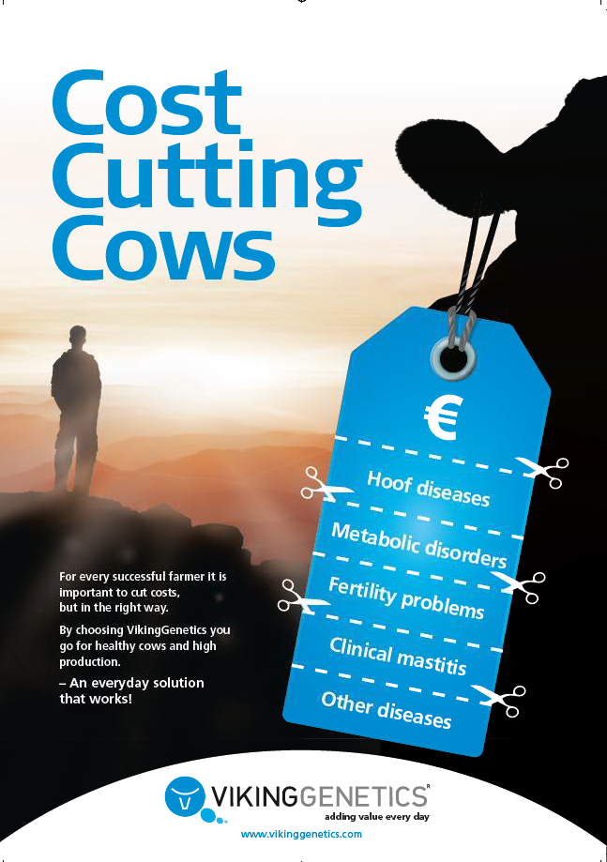
How to create profit
Increase income
High production
Keep cows longer = higher production
Slaughter animals
Export / Sale of heifers
Lower the costs
Less diseases
Easier cows = less work
Better reproduction

Slide 11



NTM is profitability
NTM is composed by all the traits that have an economical impact on the dairy business
Approx. 10 euro per unit
Health & Reproduction
Functional conformation
Production
Updated: 2019-02-05

Slide 12
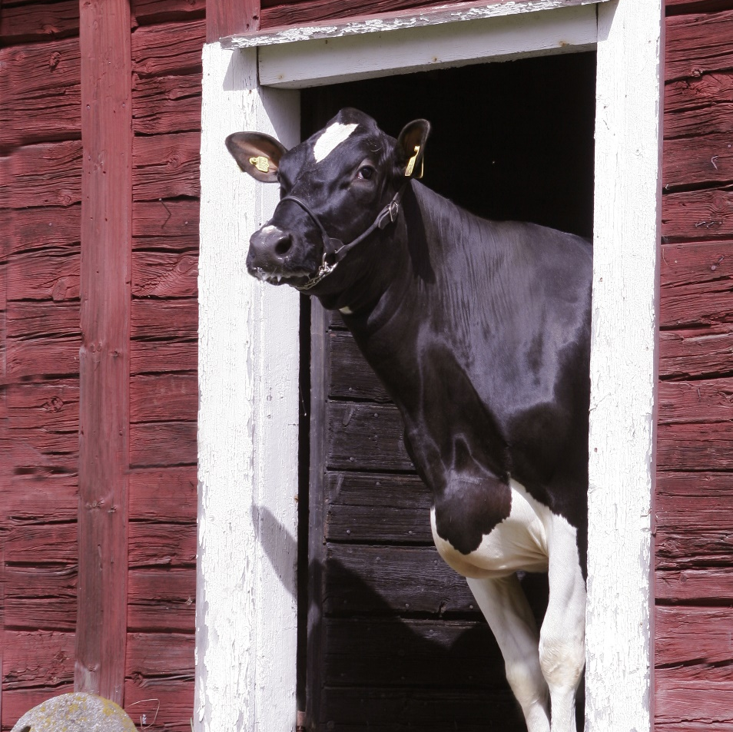
Make a long lasting cow
Trait | Correlation %
NTM | 45
Daughter fertility | 35
General health | 40
Hoof health | 32
Udder health | 46
Feet & legs | 22
Udder | 31
Yield | -8
Body | -25
Figures from Holstein genomically tested cows, NAV 2018

Slide 13
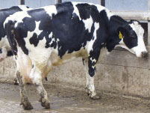
How to reduce lameness ?
Hoof problems do not only cause pain and distress for dairy cattle, but also have a huge impact on the economy of dairy farms

Slide 14
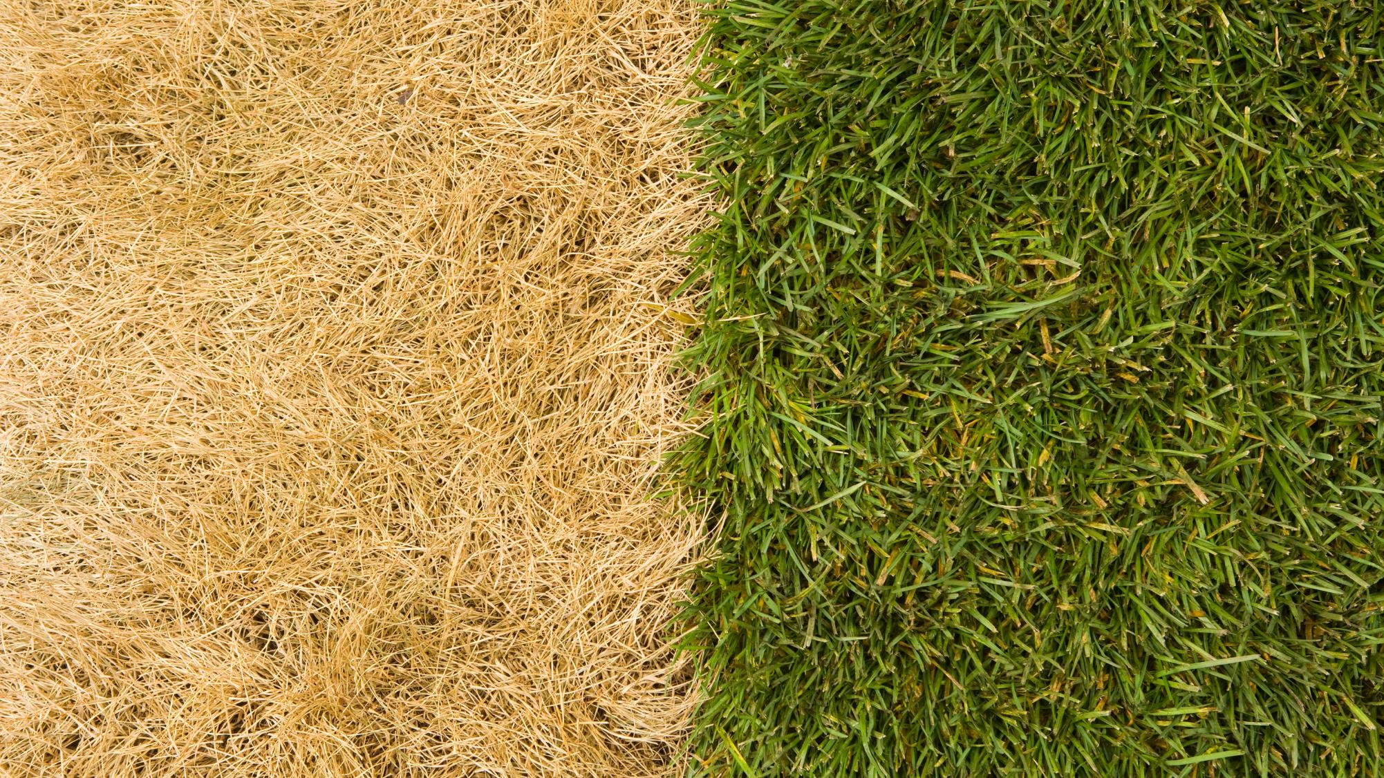


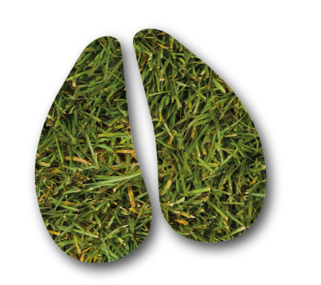


Hoof health Powered by VikingGenetics
registrations since 2003
first Hoof Health
index
2011

Slide 15
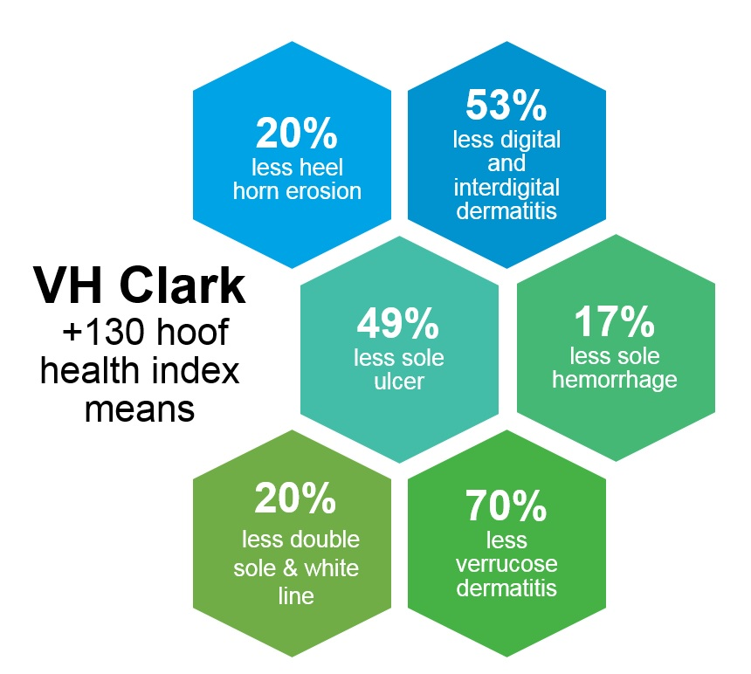
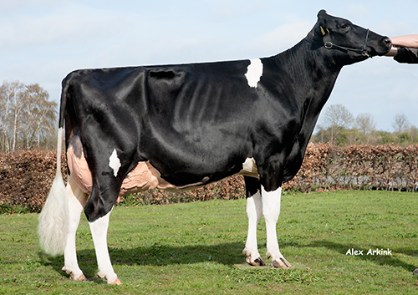
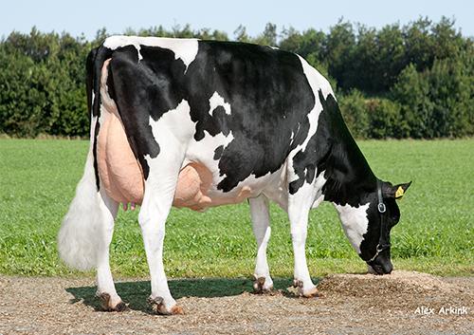
Breed for Hoof Health

Slide 16




ECM per cow, 305 days - Holstein
Source: ICAR (2018), NAV (DK, SE, FIN) & Australian National Herd Recording Statistics (2017) USCDCB (2018)
Updated: 2019-06-21

Slide 17
Kg fat + protein, 305 days - Holstein
Source: ICAR (2018), NAV (DK, SE, FIN) & Australian National Herd Recording Statistics (2017) USCDCB (2018)
Updated: 2019-06-21

Slide 18
ECM per cow, 305 days – Red Dairy Cattle
Source: ICAR (2018), NAV (DK, SE, FIN) & Australian National Herd Recording Statistics (2017)
Updated: 2019-02-10

Slide 19
Kg fat + protein, 305 days – Red Dairy Cattle
Source: ICAR (2017), NAV (DK, SE, FIN) & Australian National Herd Recording Statistics (2017)
Updated: 2019-02-10

Slide 20
Kg fat + protein, 305 days – Jersey
Source: ICAR (2017), NAV (DK, SE, FIN) & Australian National Herd Recording Statistics (2017) USCDCB (2018)
Updated: 2019-06-21

Slide 21



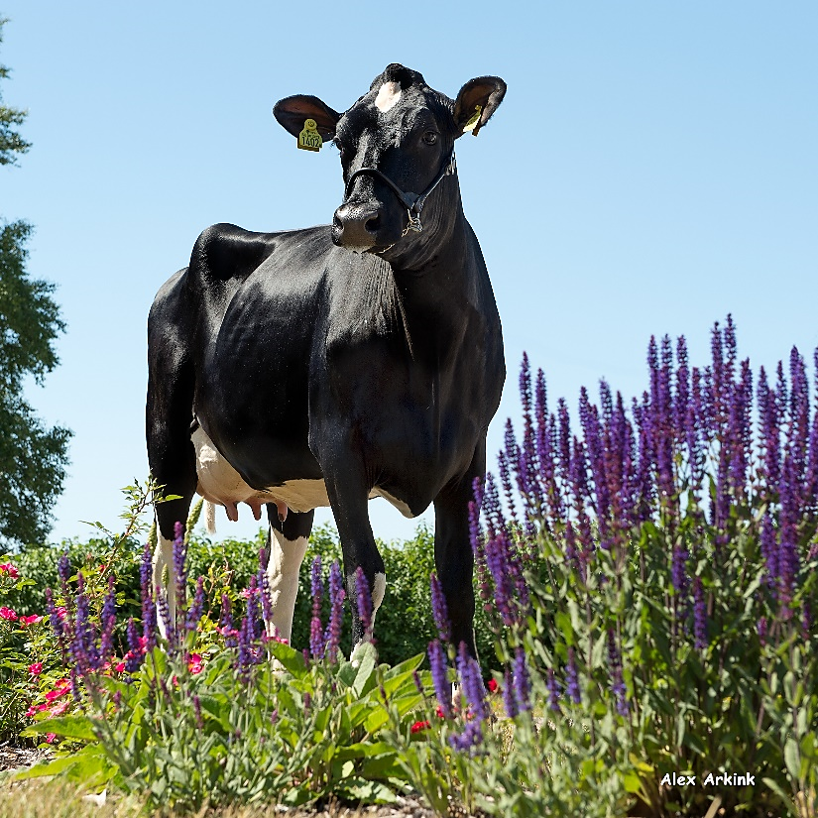
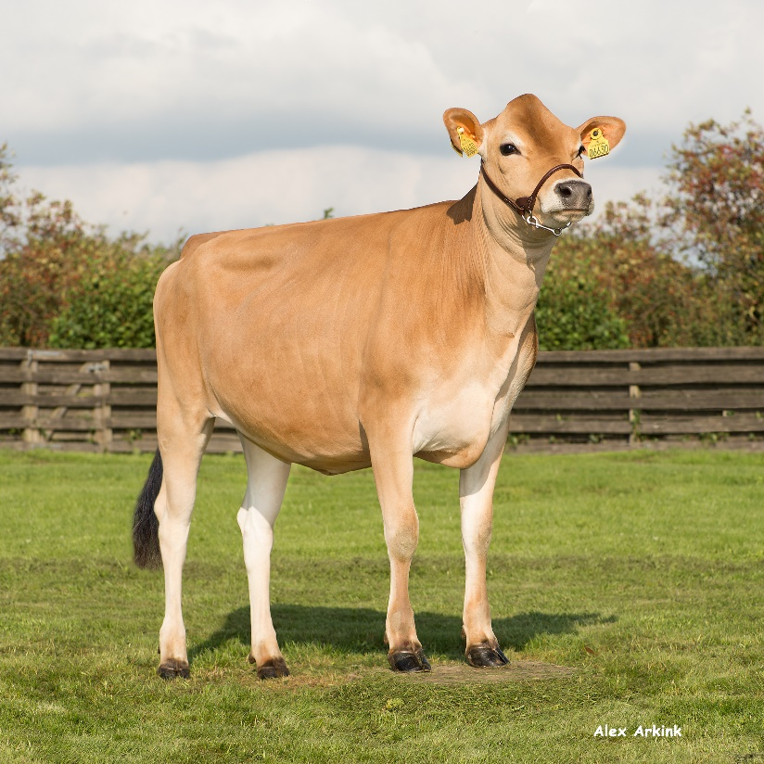
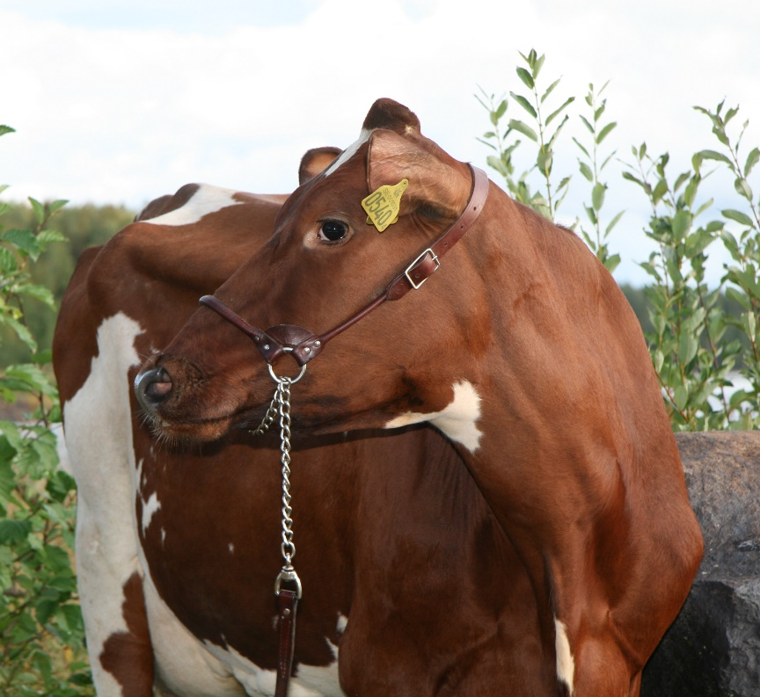
Three main breeding programmes
Notes:
3 main breeding programmes:
VikingHolstein
VikingRed (Swedish Red, Finnish Ayrshire and Danish Red)
VikingJersey

Slide 22


Dairy Cross Concepts

Slide 23
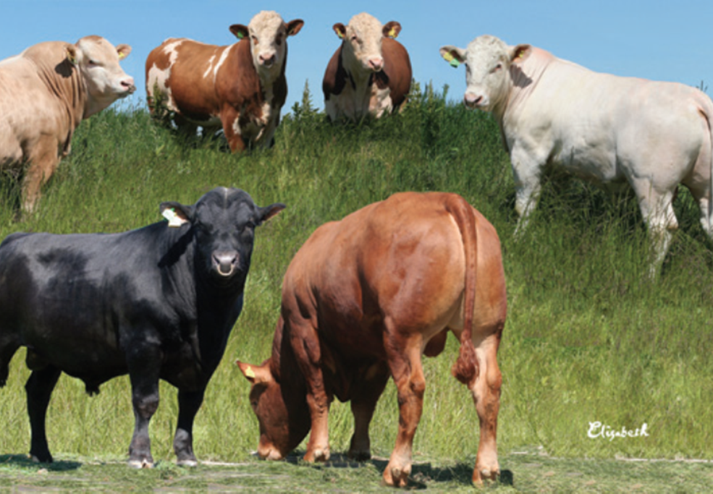
Designed for Beef x Dairy

Slide 24

Trends in dairy cattle sector
Longer lasting cows
More sexed semen
More Beef semen

Slide 25

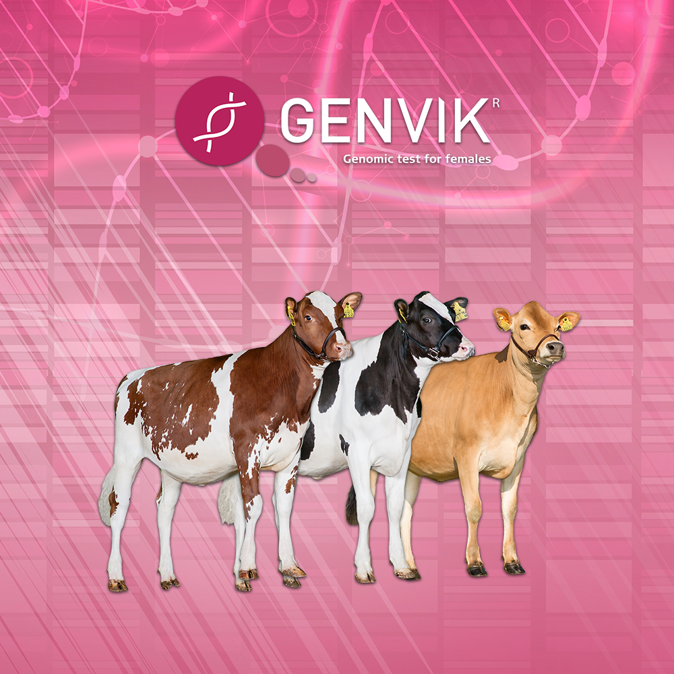
Genomic test of females

Slide 26




How to use test results
1.
Genomic test ALL heifers in the herd
2.
Evaluate and select the heifers for different strategies
3.
Use sexed semen in top heifers based on GenVik
4. Bottom part of tested heifers – for sale or breed to beef

Slide 27
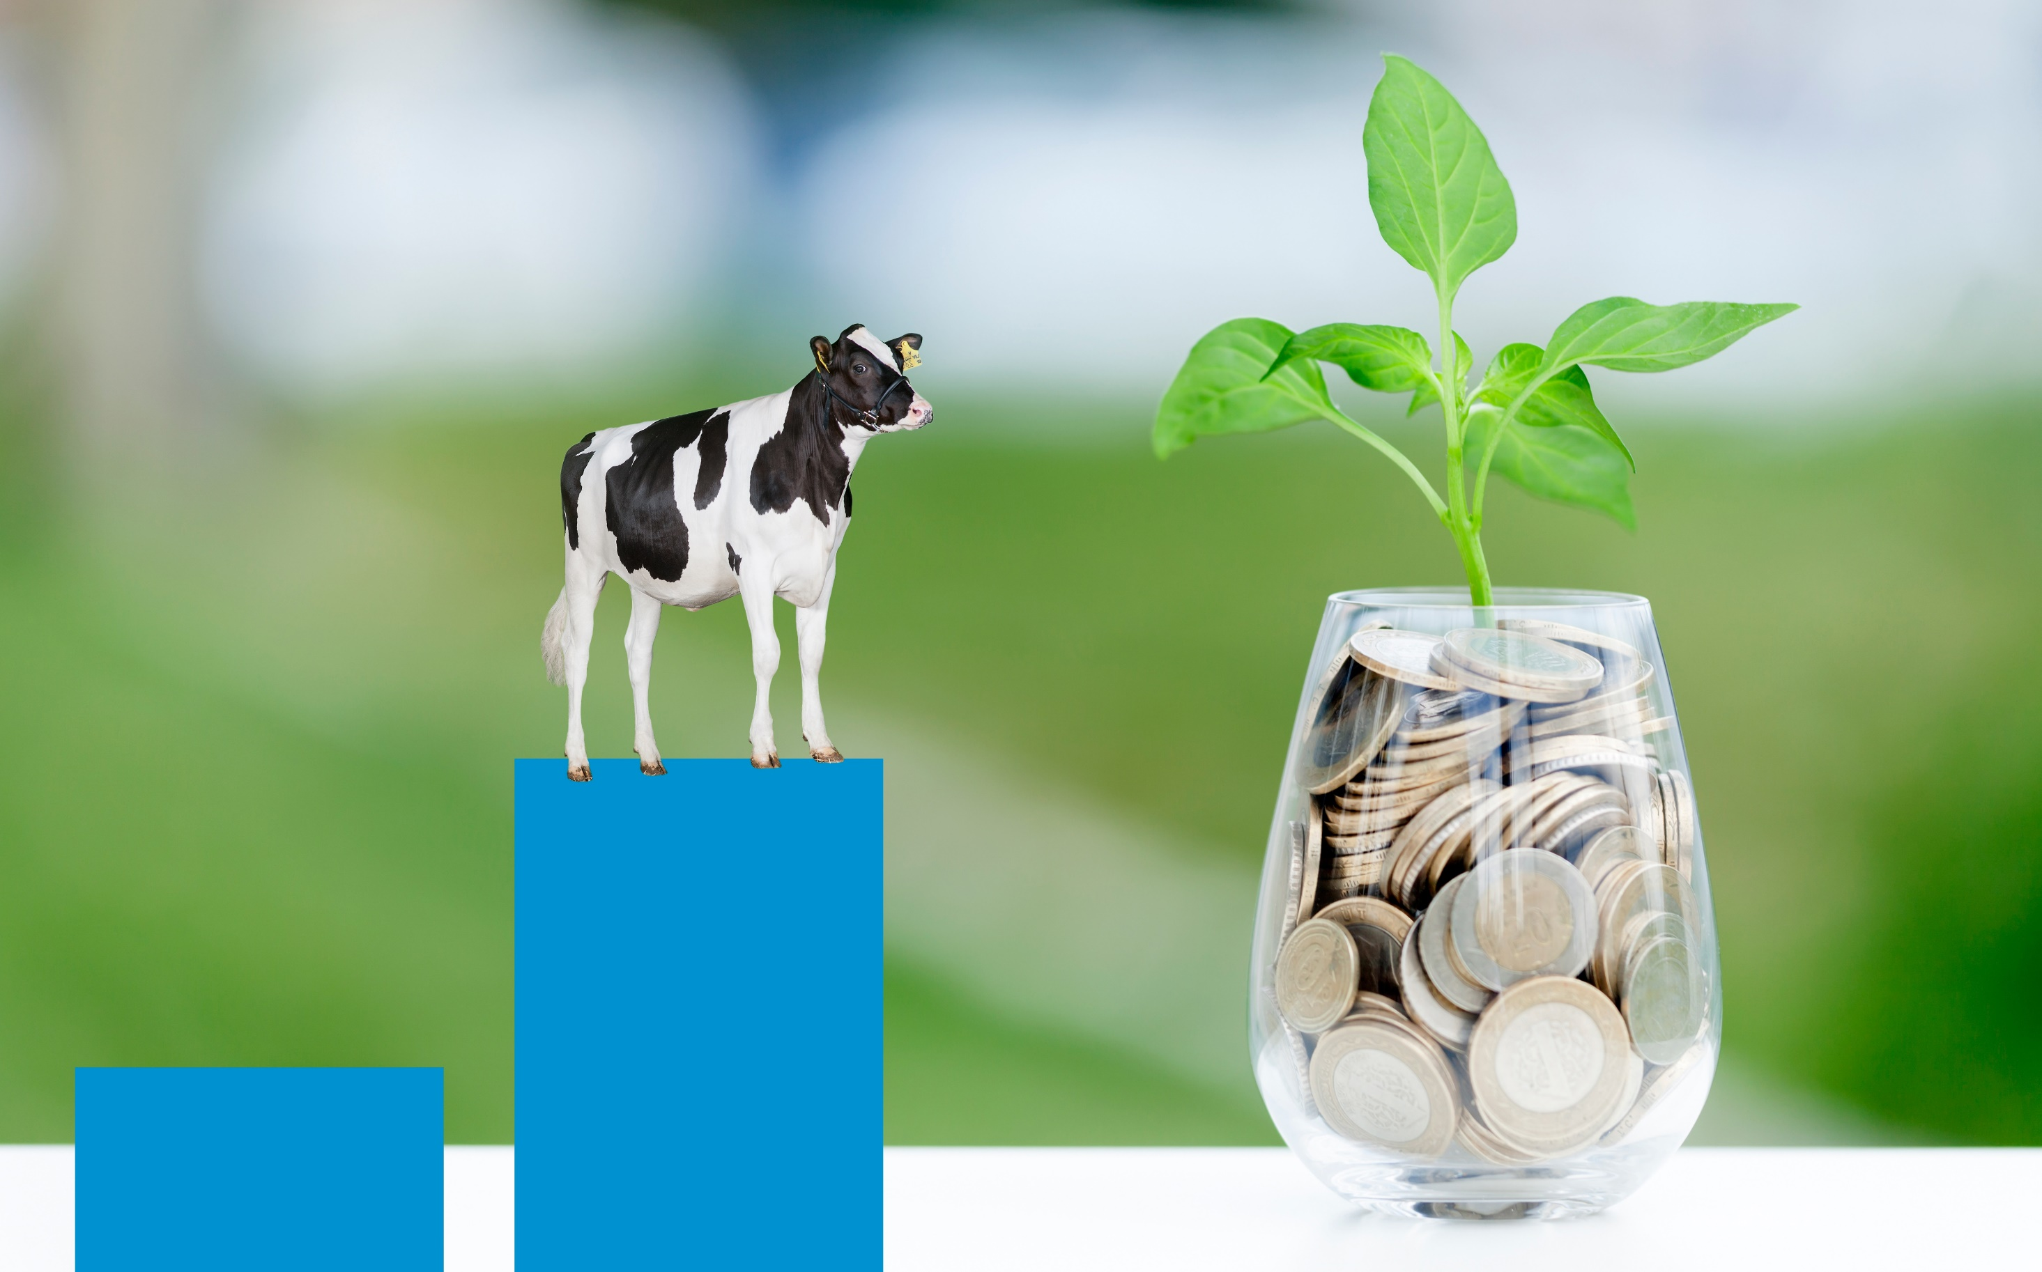



Title Subtitle
HIGHER PROFIT WITH
Extra income from higher genetic level
Cost of genomic test

Slide 28
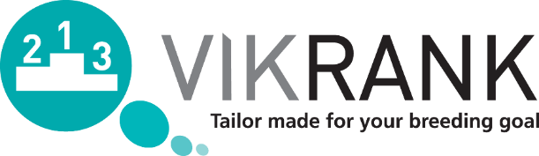
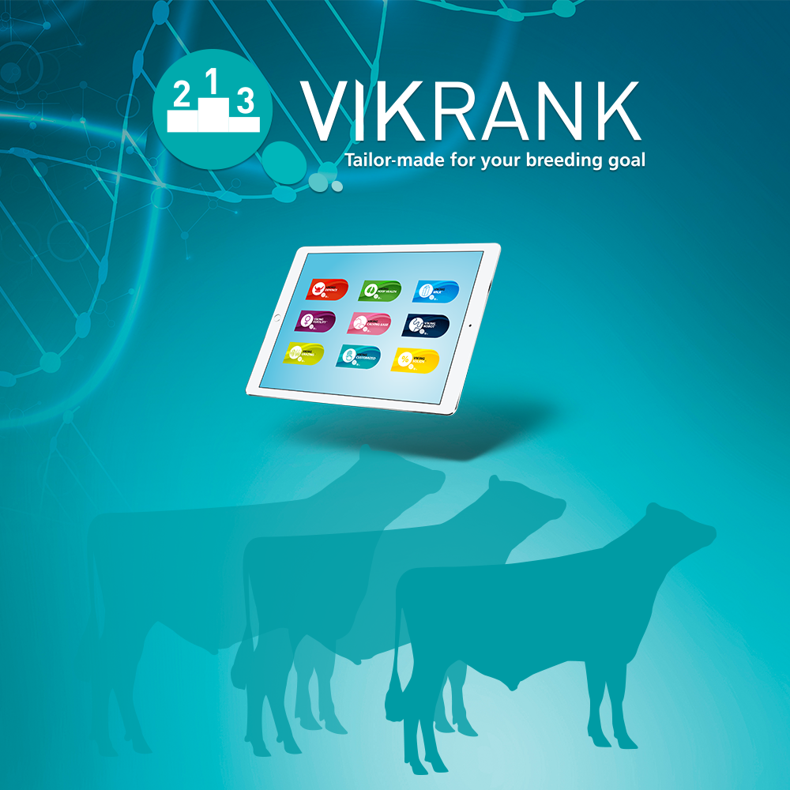









to achieve specific herd goals
Calving ease sires
A cow made for robot milking
Higher fat and protein
Customize for YOUR herd
For better daughter fertility
Healthier cows through natural defence against diseases
Increased yield
Optimal for the grazing herd
Improve hoof health
Updated: 2019-02-11

Slide 29

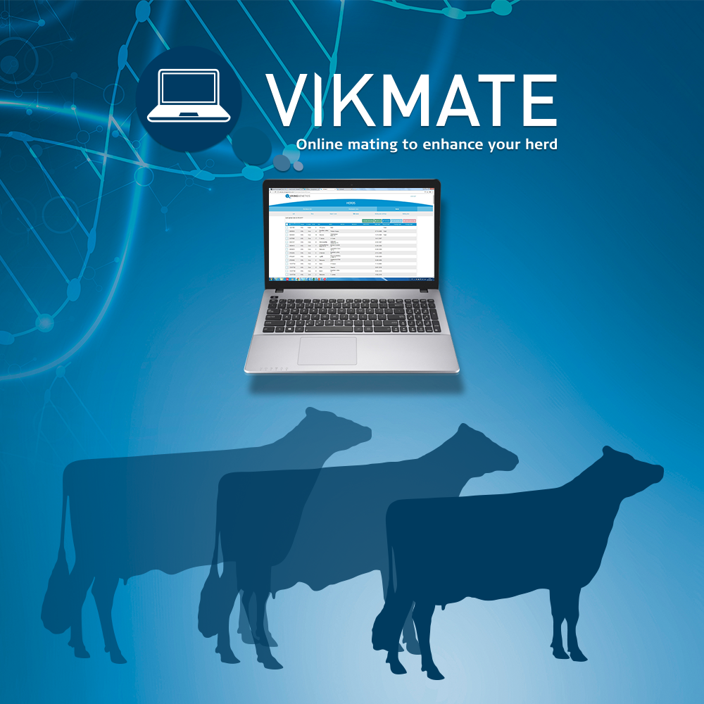
Web-based mating program
Controls inbreeding
Uses centrally controlled sire database which includes all possible bulls within Interbull
Based on individual farmer breeding goals both on herd and on individual cow level
Evaluates more than 60 different traits on each animal
Connected to VikRank = opportunity to optimize matings based on own customized breeding goal

Slide 30
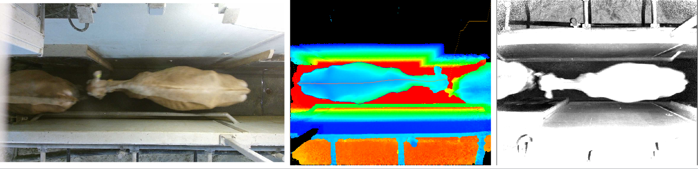
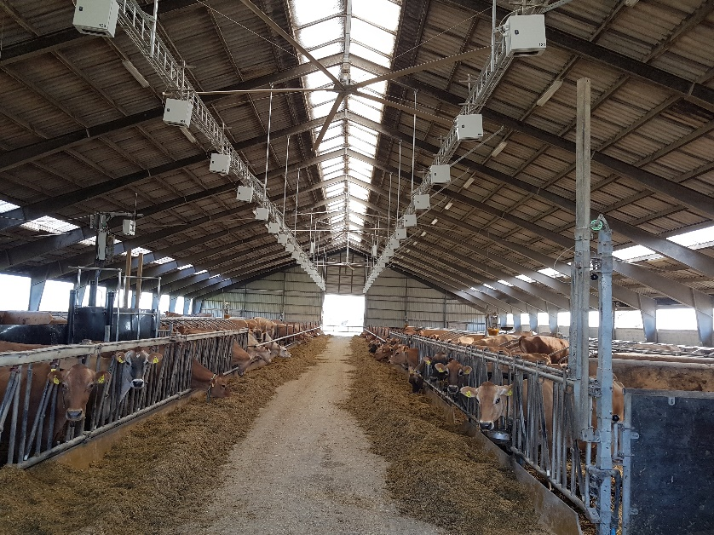

New trend: Feed efficiency
4.5 m
4.2 m

Slide 31

New trends & tools
CRISPR = Gene Editing ?
Specific milk traits
Proteins
Fatty acids
Polled
Methane & emission
???

Slide 32
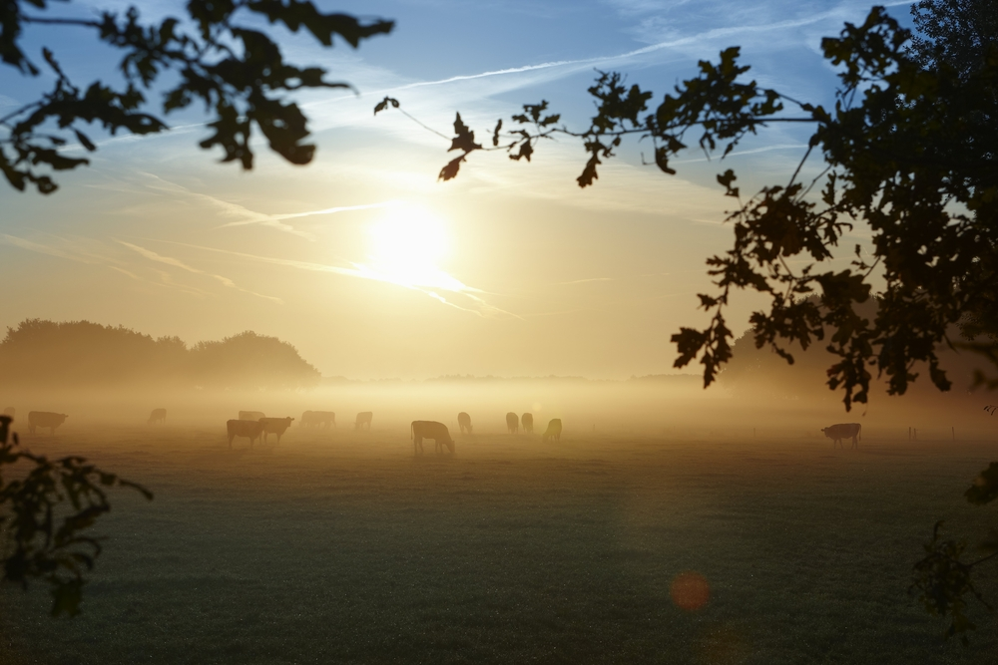

THANK YOU! Questions?

